Slide 1

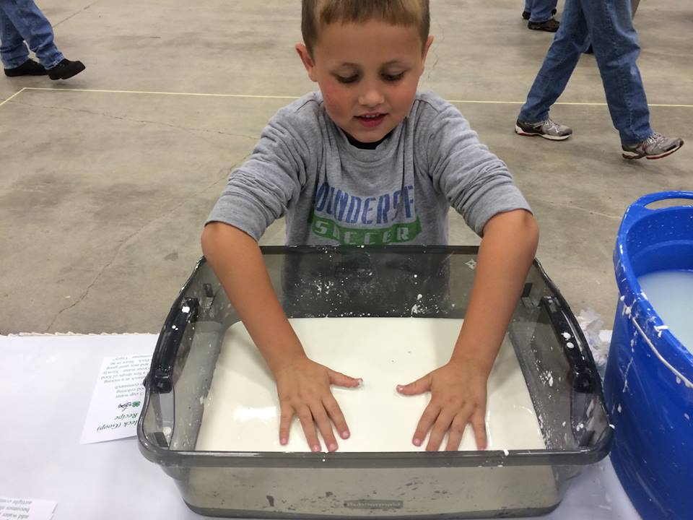
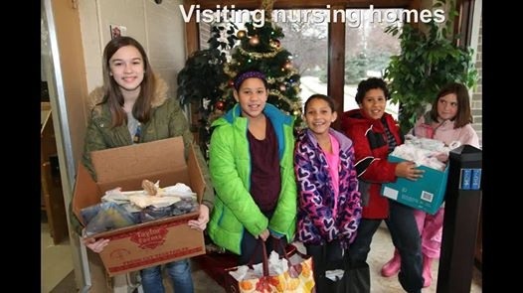
INDIANA 4-H MISSION AND VISION
Mission: Provide real-life educational opportunities that develop young people who will have a positive impact in their communities and the world
Vision: Be the state’s premier, community-based program empowering young people to reach full potential

Slide 2

INDIANA 4-H FOODS PROJECT 2015
Focused on healthy food choices
Building healthy food habits that can be carried to adulthood

Slide 3
INDIANA 4-H FOODS PROJECT 2015
Designed to help youth have fun in the kitchen as they learn:
  Basic food prep
  To try different foods
  Do fun experiments
  Go on fact finding missions

Slide 4
INDIANA 4-H FOODS PROJECT 2015
Four activity guides based on grade
  Level A 3-4
  Level B 5-6
  Level C 7-9
  Level D 10-12
Plus Helper’s Guide

Slide 5
INDIANA 4-H FOODS PROJECT 2015
Each activity guide includes:
  healthy food selection;
  smart food purchasing;
  food safety and science;
  food preparation;
  food preservation;
  careers in the food industry

Slide 6
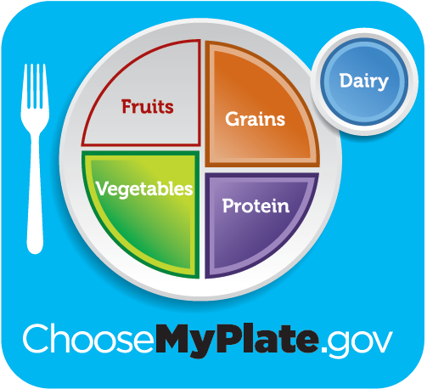
INDIANA 4-H FOODS PROJECT 2015
Recipe preparation encourages increased consumption of
  Fruits
  Vegetables
  Low-fat dairy
  Lean protein
  Whole grains

Slide 7
INDIANA 4-H FOODS PROJECT 2015
Each activity in the material includes both
  a Project Skill
  and
  a Life Skill

Slide 8
INDIANA 4-H FOODS PROJECT 2015
Recipes focused on balancing healthy food choices with occasional treats
Portion size is also discussed

Slide 9
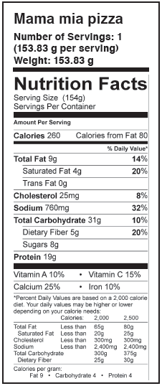
INDIANA 4-H FOODS PROJECT 2015
Nutrition facts included for each recipe
Includes challenges to increase nutritional value of recipes by adding or deleting ingredients

Slide 10
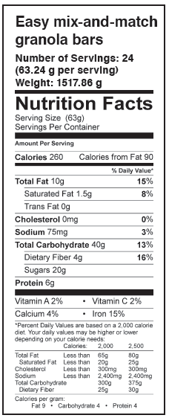
INDIANA 4-H FOODS PROJECT 2015
Nutrition facts included for each recipe
High school aged students will learn to adjust recipes for special dietary restrictions

Slide 11
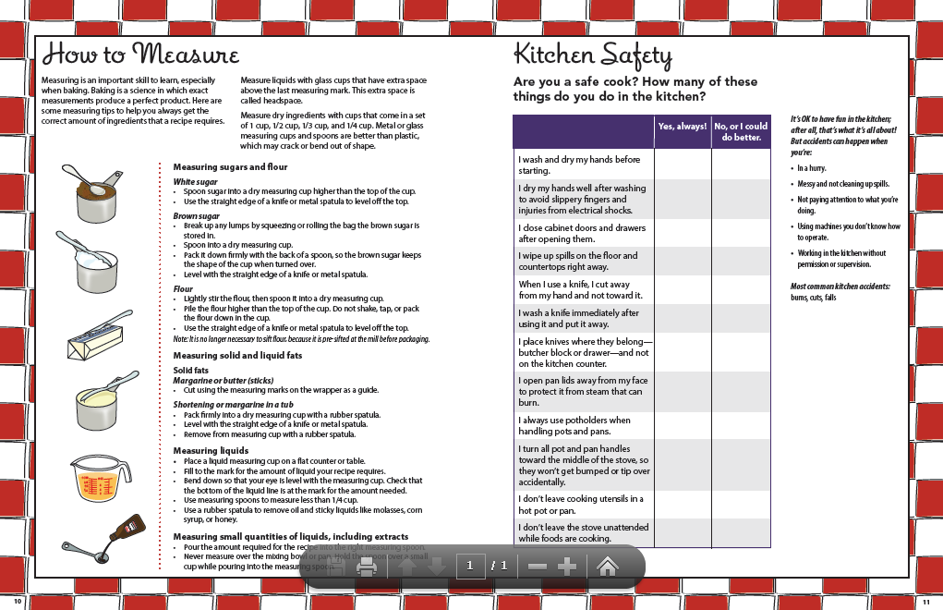
SAMPLE LAYOUT

Slide 12
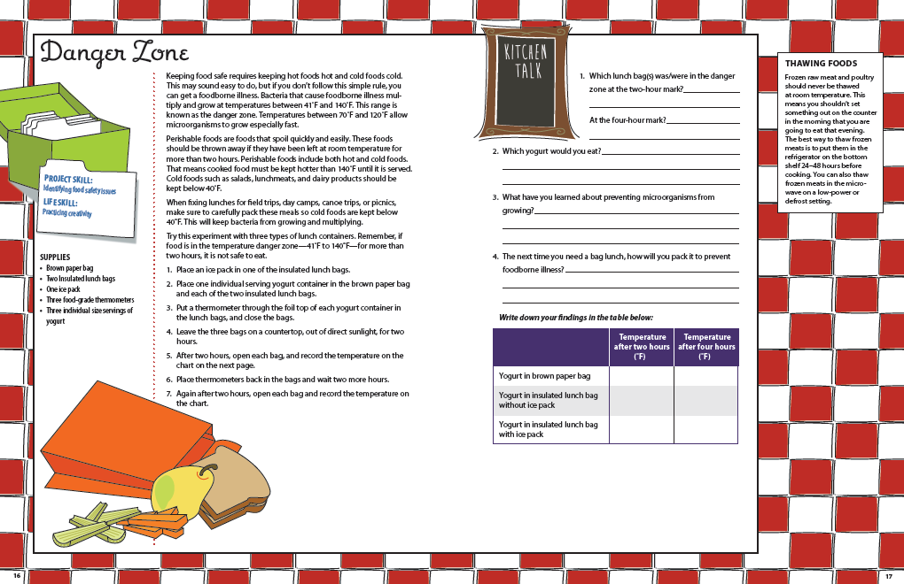
SAMPLE LAYOUT

Slide 13
Exhibit Guidelines
Level A: Grade 3- 3 baked cookies and/or frozen.
Level A: Grade 4- 3 muffins that contain an ingredient that is a source of Vitamin A or Vitamin C. Preserved option frozen berries.
Level B: Grade 5- Reduced-fat cake. Preserved option whole-grain frozen mini-pizza including 4 food groups.
Level B: Grade 6- 3 no-yeast, any shape pretzels or rolled biscuits with a whole grain flour. Preserved option one package of any frozen vegetable.
Please reference the Indiana 4-H Foods Exhibit Guidelines for complete project revisions, guidelines, and requirements.

Slide 14
Exhibit Guidelines Cont.
Level C: Grade 7, 8, and 9- 3 yeast bread sticks or yeast rolls using a whole grain. A yeast bread using a whole grain. Invented healthy snack, using 2 food groups. Preserved options, freezer jam, canned tomato product, canned pickled product or canned pickles. All using a USDA approved or Ball Blue Book recipe.
Level D: Grade 10, 11, and 12- Baked options, fruit pie, a low-fat or reduced sugar product for a catered meal or special event, product modified for a particular health condition such as diabetes. Preserved options, pressure canned vegetables, meat or combination product, frozen entrée containing 3 food groups, cooked jam or reduced-sugar fruit spread. Using USDA approved or Ball Blue Book recipes.
Please reference the Indiana 4-H Foods Exhibit Guidelines for complete project revisions, guidelines, and requirements.

