Slide 1
Supporting Family Resilience in the Aftermath of Disaster
Families Tackling Tough Times Together
Kristine Marceau, PhD, PI; Cezanne Elias, PhD, Co-PI; Kelsie Muller, MS, Co-I; Shelley MacDermid Wadsworth, MBA, PhD, Co-I; Linda Curley, MS, Lead Extension Educator
Purdue University
Project Period: 09/01/2024-08/31/2026
11/21/2024

Slide 2
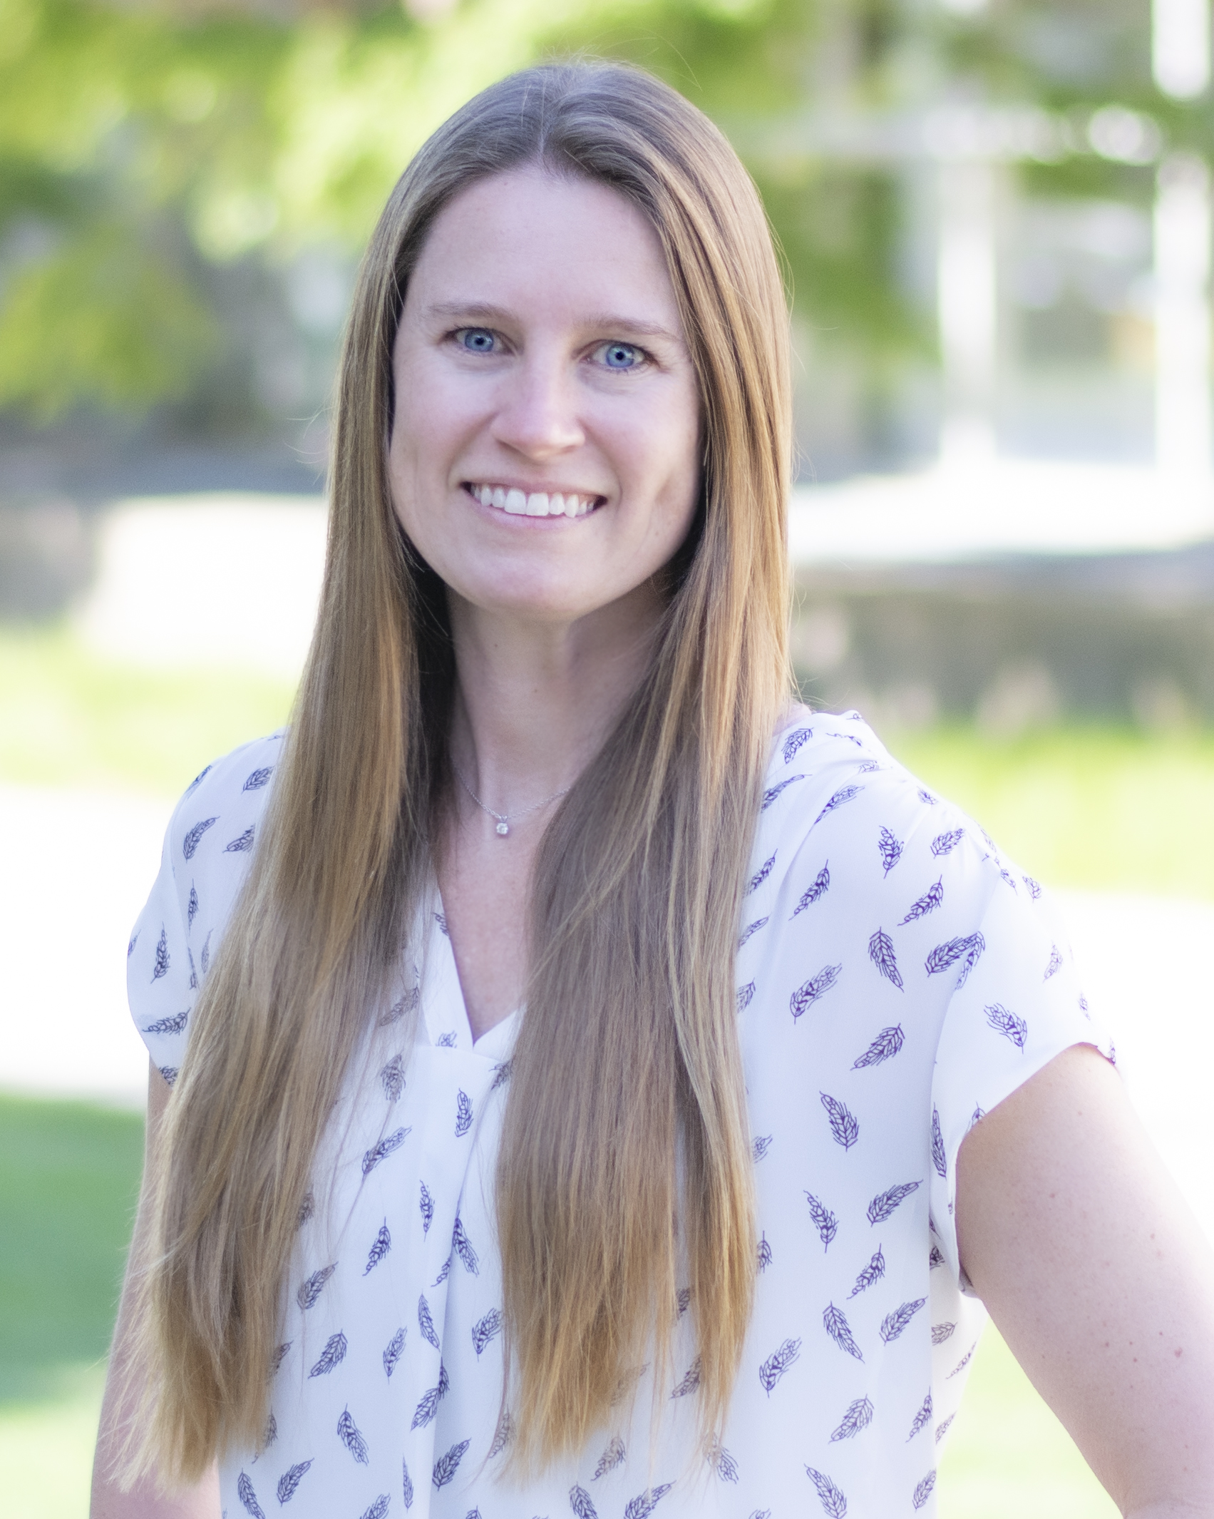
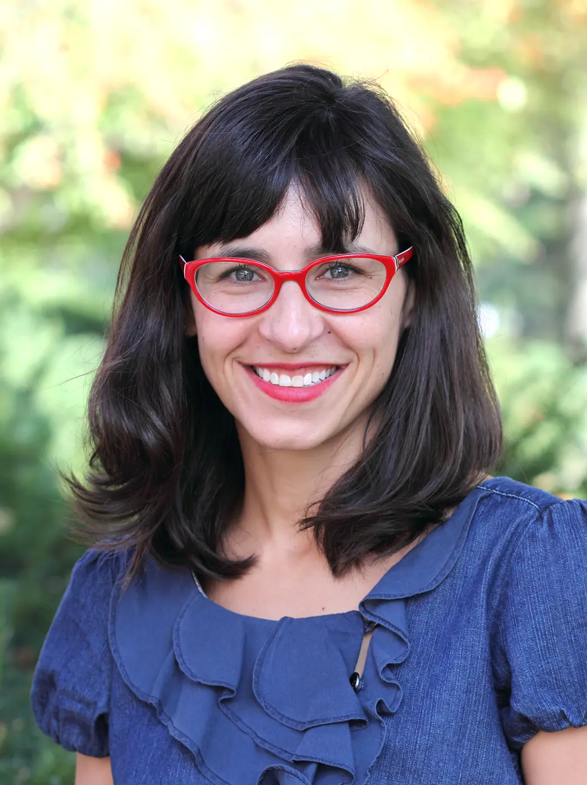
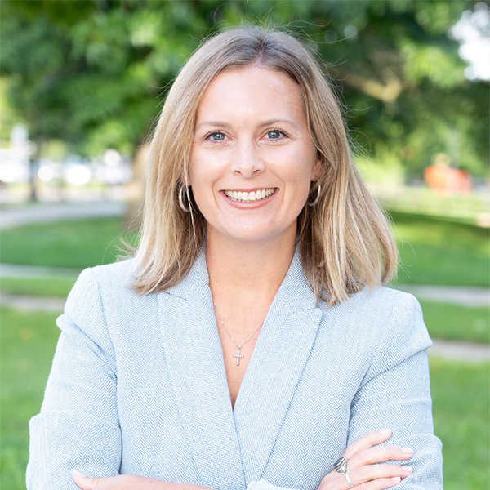
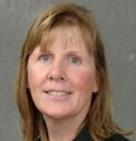
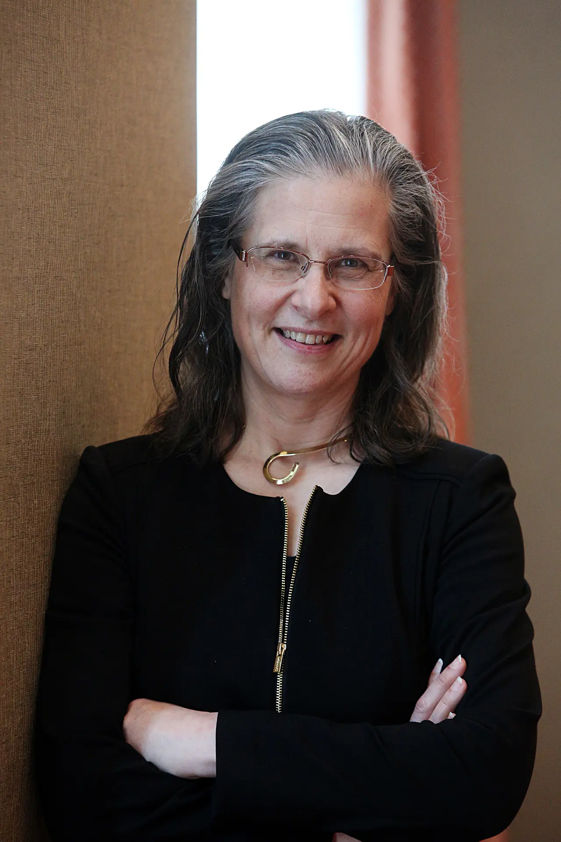
Key Personnel
Extension Leadership
Lisa Graves
Extension Educators
Allison Hillis
Ashley Drees
Shannon Shepherd
Mandy Gray
Jamie Jo Lowder
Mindy Mayes
Megan Jaspersen
With additional collaboration and support from:
EDEN
  Angie B. Lindsey
  Amanda Mosiman
Indiana PREPared and AgrAbility
  Ed Sheldon
  Bill Fild
  Shawn Ehlers
PI: Kristine
Marceau, PhD
Co-PI: Cezanne
Elias, PhD
Co-I: Kelsie
Muller, MS
Linda Curley, MS
Extension Educator
Co-I: Shelley
MacDermid Wadsworth, MBA, PhD

Slide 3
Our Project Addresses:
  Families experience stress and increased risk of later mental health problems
  FEMA support and other aid, focused on basic needs
Experience disaster
Immediate aftermath
“New Normal”, Prepare for next disaster
Medium-term recovery
  Families Together can also support sustained family resilience and preparedness for the next disaster
Our project addresses the lack of interventions to support families by levering Families Together and Extension

Slide 4
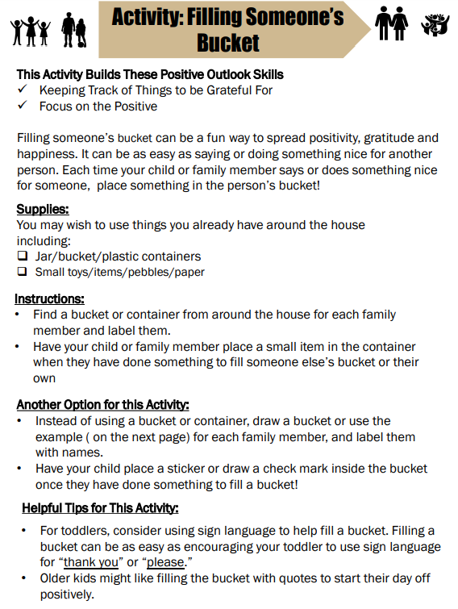
The FT Program
https://www.purdue.edu/hhs/families-together/
A theory-driven, modular, activity-based program designed to fit into families’ daily lives
Notes:
The program is based on the widely used family resilience framework developed by Froma Walsh (Walsh, 2016). It is organized into nine modules corresponding to key skills characterizing families that display resilience in the face of adversity (Ruiz et al., 2020)
FT was designed to be accessible and feasible for families regardless of their constraints – materials could be accessed by computers, mobile devices, and in some communities, via paper copies.
FT promotes resilience via activities that can be carried out as part of daily life, at whatever level of effort families feel able to expend at a given time and wherever they are (e.g., even if they are displaced from their homes and living temporarily elsewhere or moving around).
This current project will allow us to further enhance extant FT materials as well as make the streamlined and clarified program materials more widely available to the public and educators via Purdue CES and EDEN.

Slide 5
Objectives of the current USDA/NIFA grant
Refine and adapt the FT program for use in the medium-term aftermath of disasters, and to develop a manual and implementation plan that will equip Cooperative Extension System (CES) educators to help families build resilience in the aftermath of disasters.
Aim 1: Tailor existing FT materials so they are suitable for use in the aftermath of multiple kinds of disasters
Aim 2: Develop an implementation plan for rolling out revised FT materials in response to disasters in Indiana
Notes:
Notes:
Aim 1: Tailor existing FT materials so they are suitable for use in the aftermath of multiple kinds of disasters
We will identify the unique needs of families in the aftermath of disasters with respect to building family resilience and tailor existing FT materials to the identified needs. Short-term outcomes include increased knowledge among CES professionals about family resilience and disasters. The mid-term outcome of increased preparedness of CES professionals to serve families in the aftermath of disasters will support a longer-term outcome that family resilience will increase.
Aim 2: Develop an implementation plan for rolling out revised FT materials in response to disasters in Indiana
We will create a manual to facilitate Extension Educators' implementation of FT in response to disasters and disseminate the materials, manual, and implementation plan. Short-term outcomes include increased knowledge among CES professionals about available tools and plans for disaster response. The mid-term outcome of having a mechanism in place for implementing the FT program in the aftermath of disaster will facilitate a longer-term outcome that the CES will better support families after disaster.

Slide 6
Educator Roles
Aim 1. Tailor existing FT materials so they are suitable for use in the aftermath of multiple kinds of disasters
1.1. Identify the unique needs of families in the aftermath of disasters with respect to building family resilience
Specific Activities, Data collected, and Benchmarks for success |  | Outputs
Update literature review (Sept-Nov 2024, Shelley/Claire) |  | Review Publication: Strategies for promoting post-disaster family resilience
 | Data: Specific needs, published strategies for building resilience
 | Benchmark: Literature review complete
Survey Extension Educators (Sept-Nov 2024, Kristine/Kelsie; Core educators) |  | Presentation of results of co-design process and survey to Educators across Indiana and at a professional conference. Publication: Results of needs assessment co-design process and survey
 | Data: Disasters experienced; barriers/needs of families; past successes
 | Benchmark: Data collected from 40+ educators around the State of Indiana (n=84)
Develop guiding framework: needs of families and strategies to leverage FT program to meet those needs (Oct 2024 - Feb 2025, Linda)
 | Benchmark: Document drafted Oct–Dec 2024
Co-design workshop: Guiding Framework Jan-Feb 2024, Cezanne/Claire; Core educators
 | Data: Strengths, weaknesses, suggested changes for the guiding framework
 | Benchmark: Data collected from 1-2 codesign workshops with 8+ educators
Finalize guiding framework Jan-Feb 2025, Linda; Core educators |  | Guiding framework posted online
 | Benchmark: Materials updated

Slide 7
Educator Roles
Aim 1. Tailor existing FT materials so they are suitable for use in the aftermath of multiple kinds of disasters
1.2 Tailor existing FT materials to the identified needs
Co-design workshop: Materials (Mar-Apr 2025; Cezanne/Claire; Core educators) |  | Publication: Results of co-design process
 | Data: Strengths, weaknesses, suggested changes to the FT materials using the guiding framework
 | Benchmark: Data collected from 1-2 codesign workshops with 8+ educators
Update FT materials (Mar-Sept 2025; Cezanne/Claire; Core educators) |  | Materials posted online
 | Benchmark: Materials updated

Slide 8
Educator Roles
Aim 2. Develop an implementation plan for rolling out revised FT materials in response to disaster in Indiana
2.1 Create a manual to facilitate Extension Educators' implementation of FT in response to disasters
Specific Activities, Data collected, and Benchmarks for success |  | Outputs
Create manual (Mar-May 2025, Linda)
 | Benchmark: Manual drafted
Co-design workshop: Manual Development (June-Jul 2025, Cezanne/Claire; Core educators) |  | Presentation of results of co-design process and at a professional conference.
 | Data: Strengths, weaknesses, suggested changes to the manual
 | Benchmark: Data collected from 1-2 codesign workshops with 8+ educators
Update manual (Mar-Sept 2025, Linda; Core educators)
 | Benchmark: Revised Manual draft
Create implementation plan (Mar-Sept 2025, Linda/Kristine)
 | Benchmark: Plan Drafted
Co-design workshop: Implementation Plan (Sept-Oct 2025, Cezanne/Claire; Core educators) |  | Presentation of results of co-design process and at a professional conference.
 | Data: Strengths, weaknesses, barriers, new strategies for implementation plan
 | Benchmark: Data collected from 1-2 codesign workshops with 8+ educators
EDEN review of manual and implementation plan (Oct-Nov 2025, Kristine)
 | Data: Problems and suggested changes for manual and implementation plan
 | Benchmark: Comments from EDEN subject matter experts received, discussed during a meeting with PI team.
Finalize manual and implementation plan (Dec-Mar 2025, Kristine) |  | Manual and implementation plan posted online
 | Benchmark: Documents completed

Slide 9
Educator Roles
Aim 2. Develop an implementation plan for rolling out revised FT materials in response to disaster in Indiana
2.2 Disseminate Materials, Manual, and Implementation Plan
Conduct training with extension educators (May-Aug 2025, Cezanne/Claire; Core educators) |  | Publication: New FT materials including manual and implementation plan, results of co-design process for manual and implementation plan
 | Benchmark: One-to-two trainings offered; at least 20 extension educators attended
Distribute materials via Extension and EDEN (May-Aug 2025, Kristine/Shelley)
 | Benchmark: Updated FT materials, manual, implementation plan posted on website, shared with EDEN network

Slide 10
Guiding Framework
Draft courtesy of Linda Curley
Key considerations for adaptations of FT materials: Using a hands-on or activity-driven approach…
Families needs come first – embracing creativity in program delivery.
Focus on preparedness – (FEMA, STEP, STEP Up, EDEN)
Focus on optimism, positive attitude, identifying feelings, strong communication, connectedness (for child/youth and adults)
Focus on identifying or building social networks - family, friends, social services, social support (for child/youth and adults)
Creating an action plan – collaborative problem-solving, developing coping mechanisms for self, family, and community
Consider as a stand-alone (e.g., handouts for families, linked to social media posted, back to school materials, provided at fairs and shelters) and/or as companion materials to other programs

Slide 11
Preliminary Results from Educator Survey
Brief 3-5 minute survey
Purpose: to learn about the disasters extension educators around the state have experienced in their community, their perceptions of the needs of families in those situations, and the resources, initiatives, and/or activities that have proven most successful in disasters in their communities in the past.
This study was approved by Purdue University IRB #: IRB-2024-1425 “Supporting Family Resilience in the Aftermath of Disasters”. There was no participant compensation
Full results are available in the attached .html document

Slide 12
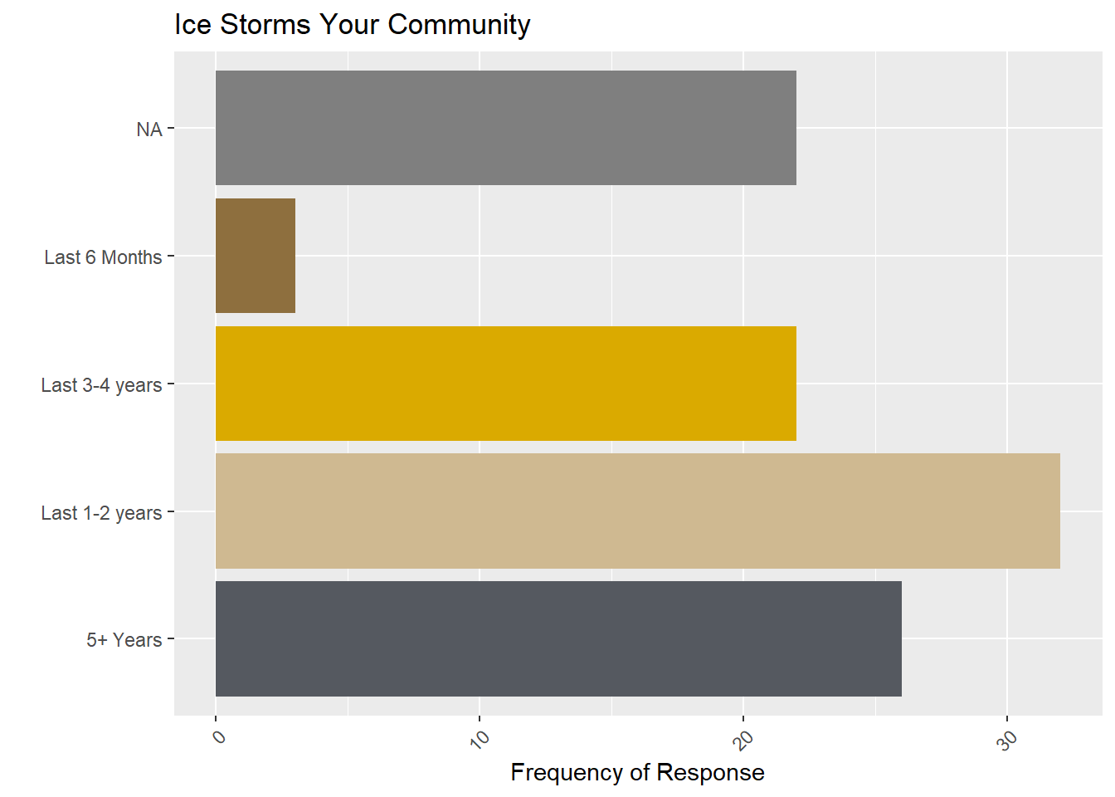
Disasters Experienced
Top responses:
Ice storms
Tornadoes
Droughts- last 6 months especially
Perceived problems
(in other communities)
Winter storms (last 1-2 years)
Heat waves, tornadoes, and flooding
(last 6mo)
Extended power outages (6mo-2y)
Community and school safety (6mo)

Slide 13
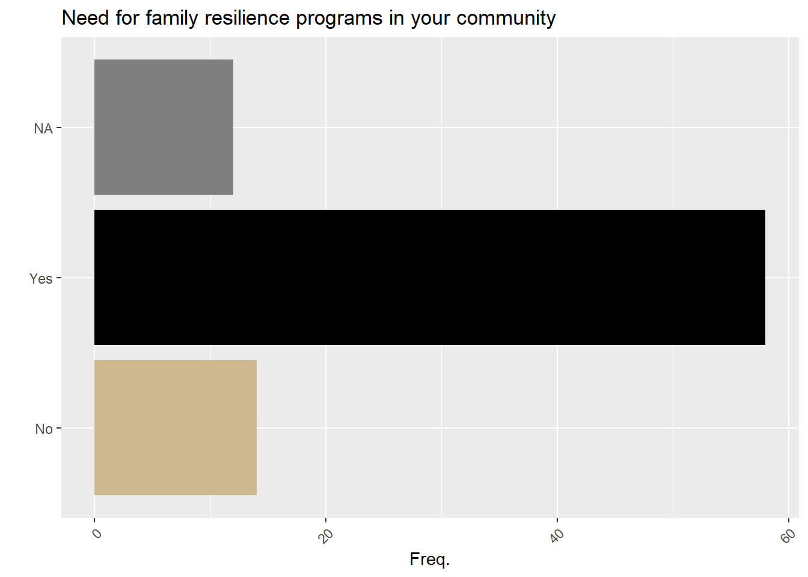
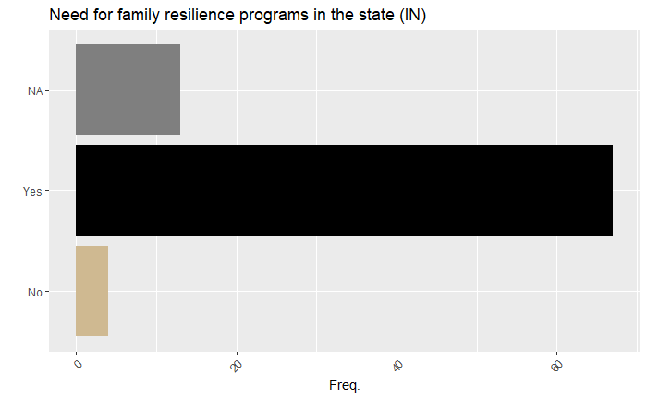
Need for Programs in the community

Slide 14
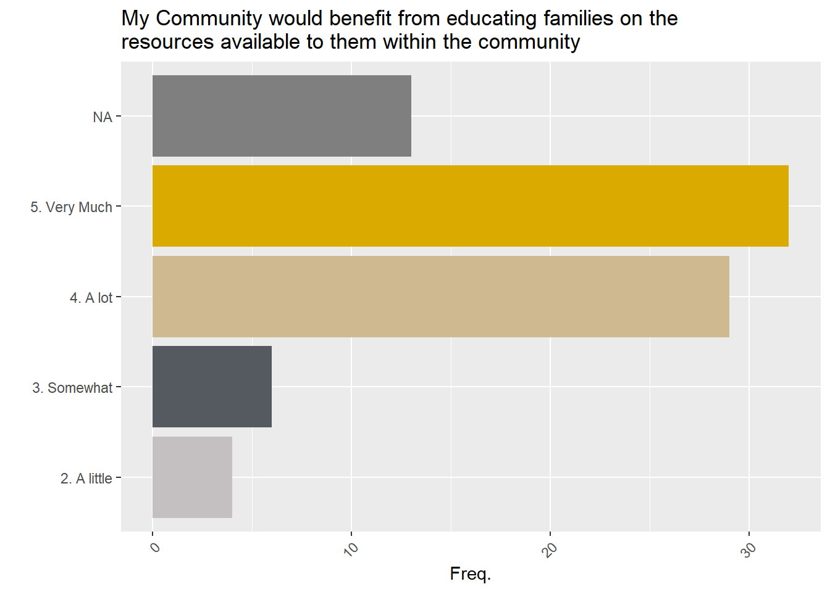
Specific Needs
Not at all – a little – somewhat – a lot – very much
Data on rates: Not at all – a lot (most = somewhat)
Educating families:
How to prepare: Somewhat – very much (most = a lot)
Resources available: a lot – very much (most = very much)
Community support groups
BEFORE disaster: A little to a lot (most = a lot, 2nd somewhat)
AFTER disaster: A little to very much (most = a lot)
One-on-one programming
BEFORE disaster: A little to a lot (most = a lot)
AFTER disaster: Somewhat to a lot (most = a lot)
Programming families work through on own
BEFORE disaster: A little to a lot (most = a lot)
AFTER disaster: Somewhat to a lot (most = a lot)
* Plot looks very similar for “in the state”,
As opposed to “in community” (depicted)

Slide 15
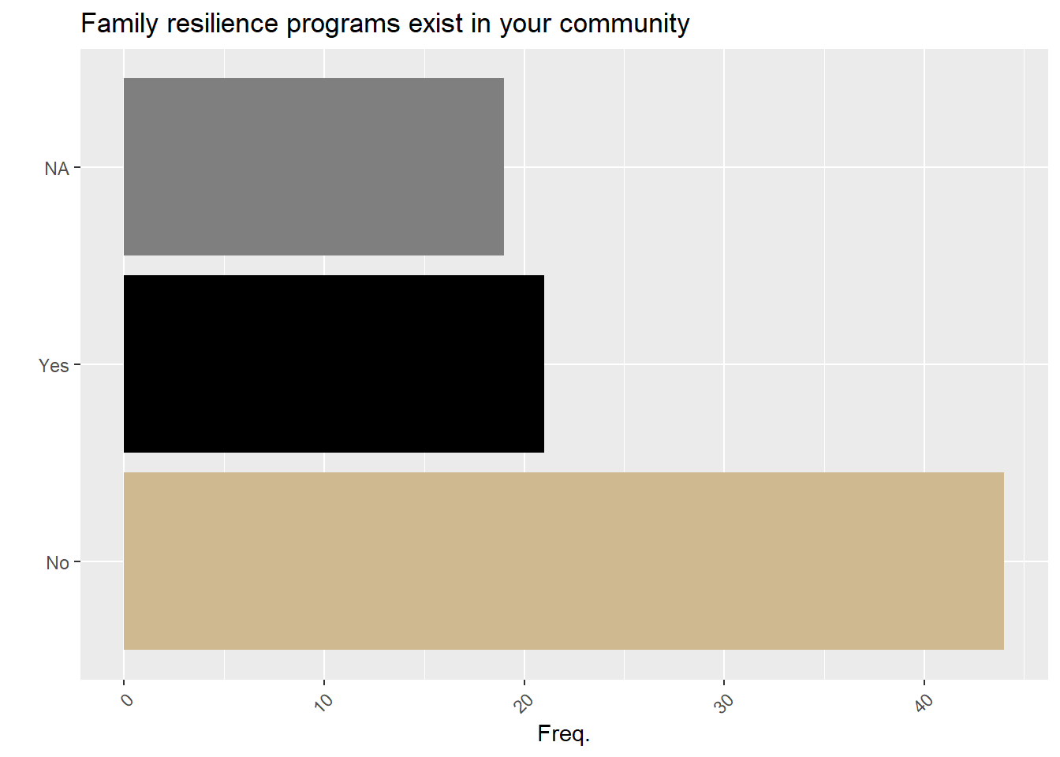
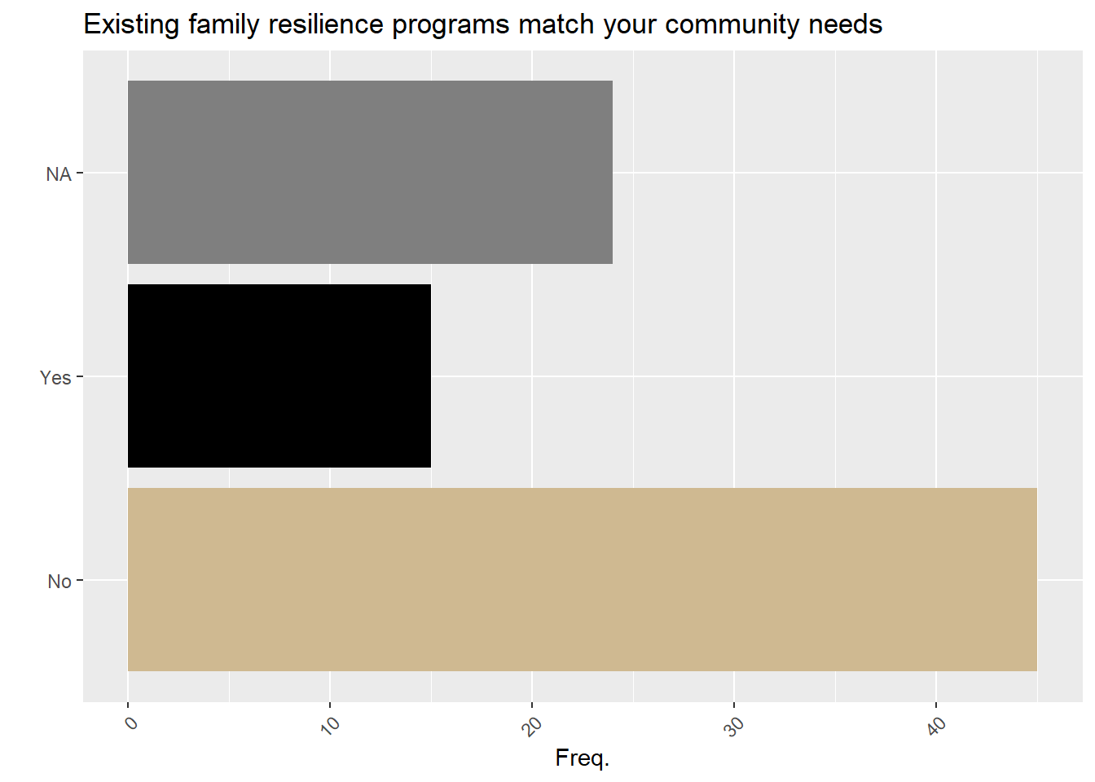
What exists
Red Cross, social service agencies, family-centered services, United Way, churches etc.
Things that address immediate needs, not skills
Grass-roots community coming together
A lot of “I don’t know”/unaware write-ins

Slide 16
Barriers
Availability of resources – 33 (49%)
Knowing what the resources are/how to access – 58 (86%)
Availability of programs – 46 (67%)
Knowing what the programs are/how to access – 55 (82%)
Availability of community support – 25 (37%)
Knowing what /how to access community support – 48 (72%)
Stigma in asking for support/resources – 38 (57%)
Lack of culturally appropriate/sensitive programming/resources – 28 (42%)
Other – 10
Money, Language, People don’t want to gather, Transportation, resources exist in silos

Slide 17
Thank You!
Questions?
Email KristineMarceau@purdue.edu

