Slide 1
2022
Mandela Washington Fellowship
Notes:
We had an Orientation Session on 6/10 (separate deck on this drive). Led by Bill Arnold
Session 1 of 5: Business Model Canvas (separate deck on this drive: Intro_to_BMC_Ignite). Led by Bill Arnold, 6/13/2022 (did the Risk Types as a lead in)
Session 2 of 5: In this deck, Risk Types (3 – 7), Communicating Your Idea (8 – 14), Problem Statement (15 – 19) Led by Bill Arnold, 6/23/2022 (Communicating and Problem Statement)
Session 3 of 5: In this deck, Market Segmentation (20 – 28), Customer Archetype (29 – 36). Scheduled for 7/1/2022
Session 4 of 5: In this deck, Market Landscape (37 – 43), Market Size (44 – 46), Revenue Models (47 – 48). Scheduled for 7/7/2022
Session 5 of 5: In this deck, Competitive Profile (49 – 51), Team (52), Milestones (53 – 55). Scheduled for 7/11/2022

Slide 2
TABLE OF CONTENTS
03
08
13
15
20
29
Risk &Return
Communicating Your Idea: Napkin Drawing
Communicating Your Idea: Intrigue Statement
Problem Statement
Market Segmentation
Customer Archetype
37
44
47
49
52
53
Market Landscape
Market Sizing
Revenue Models
Competitive Analysis
Team
Milestones

Slide 3
Technology Risk
Financial Risk
Market Risk
People Risk

Slide 4
Technology Risk
Technology Risk
Can it be protected?
Is it reliant upon other technologies?
How long does it take to build?

Slide 5
Financial Risk
Financial Risk
Market size
Clear business model
Capital needed
Future exit

Slide 6
People Risk
People Risk
Right skills?
Domain expertise
Startup experience
Network

Slide 7
Market Risk
Market Risk
Validated customer willing to pay?
Product-market fit?
Competition?
Barriers to entry?

Slide 8
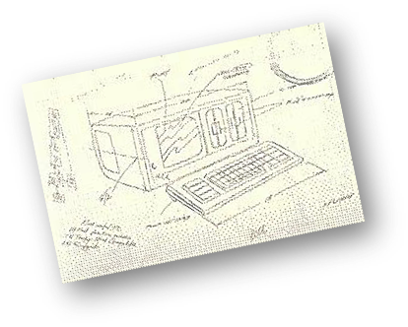
Napkin Drawing
Clearly Communicate through visuals
What it is
What purpose it serves for the customer
NOT how it works
Avoid technical jargon

Slide 9
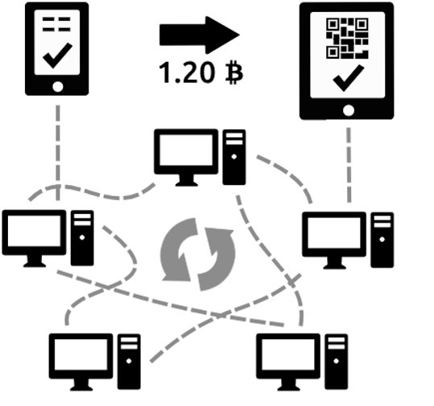
Napkin Drawing

Slide 10
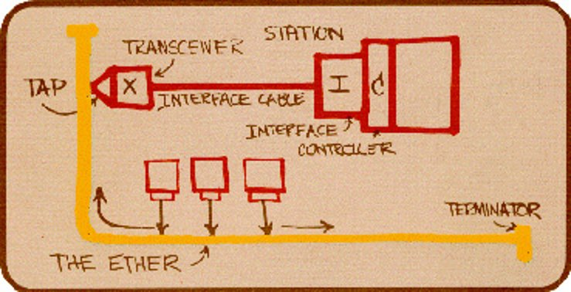
Napkin Drawing

Slide 11
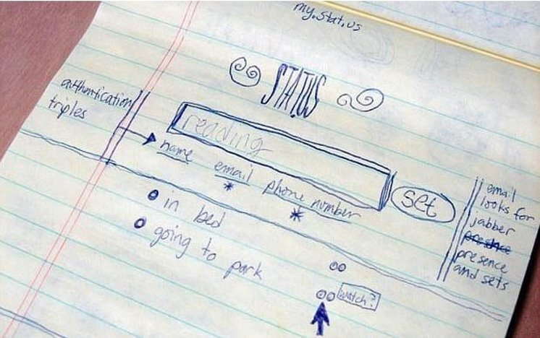
Napkin Drawing

Slide 12
Networking Scenario
A Letter from the Leaders
A message from President Daniels
A message from Brian Edelman
A message from the mayor of West Lafayette, IN

Slide 13
Networking Scenario
explanation
converse
understanding
A Letter from the Leaders
A message from President Daniels
A message from Brian Edelman
A message from the mayor of West Lafayette, IN
Create Intrigue
Allow the other person to lead the conversation and ask questions.
“I have , it does for customer.”

Slide 14
Methods for Sharing
2 Sentence Intro
2 Minute Pitch
Product
Differentiator
Target customer
+ Customer Problem
+ Market Size/ Landscape
A Letter from the Leaders
A message from President Daniels
A message from Brian Edelman
A message from the mayor of West Lafayette, IN
Story
20 Minute Pitch
+ Go to market
+ Milestones
+ Competitors
+ Financials

Slide 15
Problem Statement
Quantified
One Problem
Validated

Slide 16
Problem Statement
Cordian
Cardiac Diagnostic Image Analysis: The facts about your heart
According to the CDC, Cardiovascular disease (CVD) is the number one killer in the US and its costs are expected to exceed $1.3 trillion by 2030.
CVD affects more than 75M people every year in the US.
But more than 50% receive the wrong diagnosis.

Slide 17
Problem Statement
Quantified
One problem
Focus on one specific problem
Big enough that the customer is willing to pay to solve it
Urgency to solve it
It either ‘saves money or makes money’
Business to Business (B2B)
Business to Consumer (B2C)
One Problem
Validated

Slide 18
Problem Statement
Quantified
Know the key metrics of the problem
How big is the problem?
Examples of metrics or data points
Number of people affected
$ spent on the problem
Amount of time lost
Quantified
One Problem
Validated

Slide 19
Problem Statement
Quantified
Validation
Statistics or data from a 3rd party source
Great resources for data:
Governing bodies
Non-profits
Non-biased researchers
One Problem
Validated

Slide 20
Market Segmentation
Exploring customer sets
Explore all possible markets for your innovation
Consider new potential applications beyond your original thinking
Determine which customers really care about your value propositions
Identify the best first customer segment

Slide 21
Market Segmentation
Exploring customer sets
Market
Segment
Segment
Segment
Segment

Slide 22
Market Segmentation
Business to Consumer
Individuals
Families
Couples
Business Travelers
Friends

Slide 23
Market Segmentation
Ways to Segment the Market
Size
Type
Industry

Slide 24
Market Segmentation
Business to Business
Manufacturing
Engineering
Companies
(By Size/Type)
Small Business
Public
Companies
(By Industry)
IT/Software
Energy
Private
Corporate
Startups
Ag Tech
E-commerce

Slide 25
Market Segmentation
Build Your Customer Segment
Market

Slide 26
Market Segmentation
Build Your Customer Segment
Market
Segment
Segment
Segment
Segment

Slide 27
Market Segmentation
Build Your Customer Segment
Market
Segment
Segment
Segment
Segment

Slide 28
Market Segmentation
Ways to Select a Target Market
Urgency!
Barriers to Entry
Access to Customers

Slide 29
Customer Archetype
Defining Your Target Customer
Narrow the market segment
Identify their pains, decision making process and people
Understand the target customer environment
Be an expert in your target customer segment
Identify INDIVIDUAL PEOPLE involved in the decision to buy.

Slide 30
Target Customer
Narrow the Segment

Slide 31
Target Customer
Narrow the Segment
Macro
Micro
Behavior
Geographic
Demographic
Behavior
Psychographic
Demographic
Location
Region
Urban/Rural
Size
Benefits Sought
Life Cycle
Buying Process
Ease of Integration
Buyer-Seller Relationship
Personality
Lifestyle
Values
Attitudes
Opinions
Location
Region
Urban/Rural
Size
Age
Gender
Occupation
Education
Benefits Sought
Life Cycle
Buying Process
Ease of Integration
Buyer-Seller Relationship
Personality
Lifestyle
Values
Attitudes
Opinions
Age
Gender
Occupation
Education
+ Industry
+ Purchasing Criteria
+ Decision Makers
+ Requirements (Referrals, etc)

Slide 32
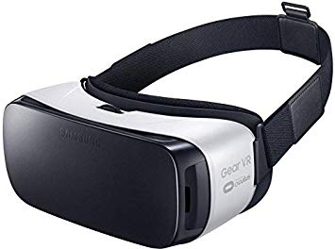
B2C Example
Virtual Reality Headset
Geographic
United States
Urban
Demographic
Male
16-24
Student
Behavior
Fun/Entertainment
Show off to friends
Christmas gift/birthday money
Continued support and new product
Psychographic
Outgoing/techie
Likes to try new things/early adopter
Good quality technology

Slide 33
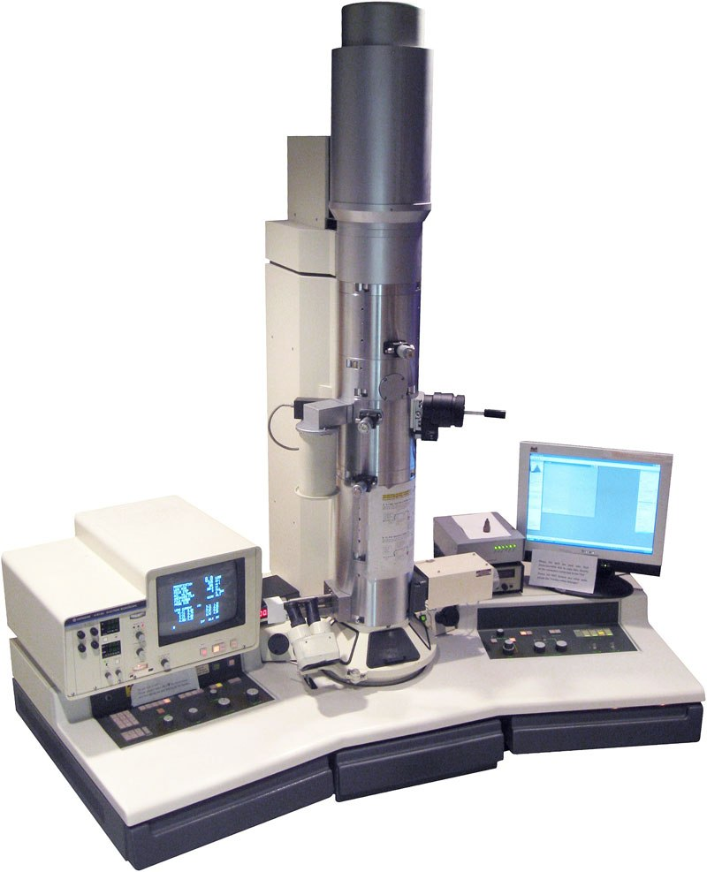
B2B Example
Electron Microscope
Macro
Universities/Colleges
United States
Research institutions
Biology Labs
15K Students
Micro
High level of magnification
Easy training process
Established lab/well funded
Purchase approval by faculty researcher + graduate student influence
Maintenance package included

Slide 34
Customer Types
Explore the Roles
Who is Involved in the Buying Decision?
End User
Economic Buyer
Person who uses the product
Person who pays for the purchase
Influencer/Saboteur
Decision Maker
People around the buyer who may influence the purchasing decision in a positive or negative way
Person who makes the final decision to buy

Slide 35
Customer Types
Virtual reality Headset
Decision Maker
Mom
Influencers:
Recommenders
Friends
Influencers: Saboteurs?
Little Siblings
Economic Buyers

Slide 36
Customer Types
Electron Microscope
Influencers: Recommender/
Saboteur
Lab Technician
End User
Graduate Student
End User
Graduate Student
Decision Maker
Professor
Decision Maker
Professor
Economic Buyer
Business Office Manager
Economic Buyer
Business Office Manager

Slide 37
Market Landscape
Highlighting the Opportunity
Communicate where your idea fits
Help others understand the market and competitive solutions
Identify what values the customer cares about most
Find your product market fit
X

Slide 38
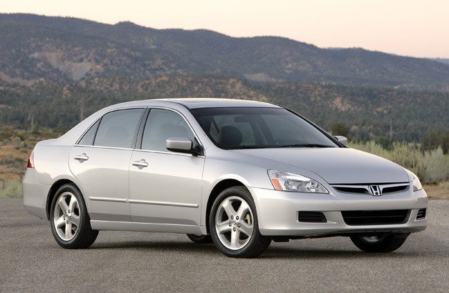
Market Landscape
Highlighting the Opportunity
What Category?

Slide 39
Market Landscape
Highlighting the Opportunity
Building the Category Map
Tips to Title Your Map:
Think at a high level – 100,000 ft view
Ask yourself- “Where does this idea fit?”
Think broadly about the alternative solutions and approaches

Slide 40
Market Landscape
Highlighting the Opportunity
Brainstorm Current Technologies
Tips to Brainstorm Categories:
Ask yourself “What are the alternative ways the problem is being solved today?”
Think categories, not individual products
Consider all possible solutions, even low-tech options

Slide 41
Market Landscape
Highlighting the Opportunity
Market Drivers
Tips to Determine Market Drivers:
Ask yourself “What is driving people to choose one solution over another in the market today?”
Choose your drivers based on your ideal customer
Do NOT consider cost/price

Slide 42
Market Landscape
Map Your Drivers & Categories
Highlighting the Opportunity
MOBILE DEVICES
Laptop Computers
Tablet Devices
Smart Phones
Functionality
Smart Watches
E-reader
Cellular Phones
Smart Pens
Portability

Slide 43
Market Landscape
Highlight the Opportunity
Highlighting the Opportunity
MOBILE DEVICES
open
Laptop Computers
open
Tablet Devices
Smart Phones
Functionality
Smart Watches
E-reader
Cellular Phones
open
Smart Pens
Portability

Slide 44
Market Sizing
How Big is your Opportunity?
Total Available Market
Total possible demand for product
Cardiovascular Ultrasound $16B
Annual - US
Serviceable Available Market
Segment of total available market
Echocardiography
$6B
Annual - US
Target Market
Based on current business model
Echocardiography
5 Hospitals
$10M
Annual - US

Slide 45
Market Sizing
Quantify each market based on
Characteristics
How many users/businesses
$/year currently spent on solution
How Big is your Opportunity?
TAM
Total Available Market
Total Available Market
Total possible demand for product
SAM
Serviceable Available Market
Serviceable Available Market
Segment of total available market
SOM
Serviceable Obtainable market
(Target Market)
Target Market
Based on current business model
Beachhead Market
Beachhead Market
Based on current business model

Slide 46
Market Sizing
Top Down
Market Research
Bottom up
Guesstimate
Defensible Logic
Unit Economics
How Big is your Opportunity?
TAM
Total Available Market
Total Available Market
Total possible demand for product
SAM
Serviceable Available Market
Serviceable Available Market
Segment of total available market
SOM
Serviceable Obtainable market
(Target Market)
Target Market
Based on current business model
Beachhead Market
Beachhead Market
Based on current business model

Slide 47
Revenue Models
How Will You Make Money?
Pfizer
Target
Intel
Gillette
Direct Sales/Service
Retail/Online
Original Equipment Manufacturer
Razor/Blade
Xerox
Pandora
Netflix
Qualcomm
Lease/Consumables
Freemium
Subscription
Licensing

Slide 48
Revenue Models
How Will You Make Money?
Uber
AirBnB
Lyft
Kickstarter
Platform
Platform
Platform
Platform
Priceline
eBay
PayPal
Facebook
Platform
Platform
Platform
Platform

Slide 49
Competitive Profile
Who is Your Competition?
Understand who the competitors are in your market
Learn their strengths and weaknesses
Evaluate and compare based on measures the customers care about
Evaluation metrics to consider
Ease of use
Accuracy
Quality
Price
Customizability
Size or weight

Slide 50
Competitive Profile
Metrics and Competitors
Evaluation Metrics
Ease of use
Accuracy
Quality
Price
Customizability
Size or weight
Types of Competitors
Direct
Indirect
Unknown

Slide 51
Competitive Profile
Comparing Competitors
Company/ Product
Notification
Of
Non-compliance
Data
Tracking
Quality of
Wash
Price
Per User
Washing or
Disinfecting
System
Wipe Sensor
$5
HandGenie
$8
CleanTec
$3
Hygens
$4

Slide 52
Your Team
Who Brings Value?
Team Skills
Track Record
Domain Expertise
Advisors

Slide 53
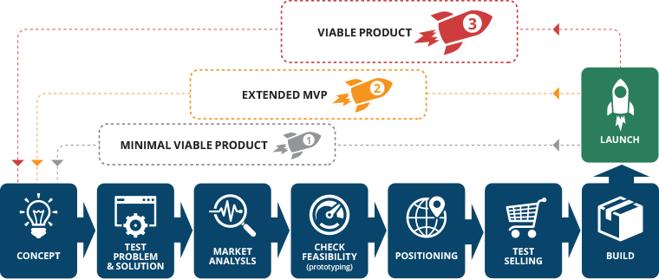
Milestones
Systematic De-Risking
Outline to the larger plan
Show ability to create detail plan
Visualize your strategic plan
Identify your goals/milestones
What do you need to do
How much money you need
How long it will take you
What risks exist
How will you address them?

Slide 54
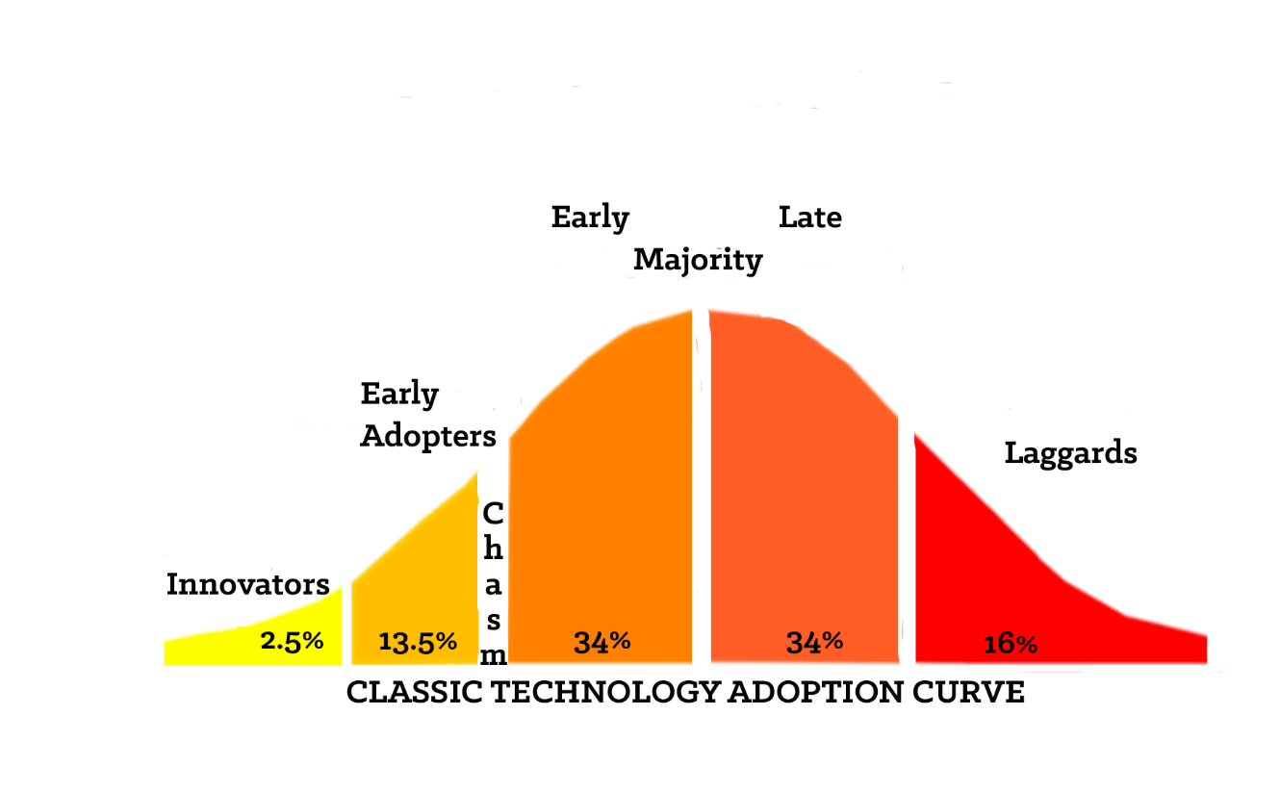
Milestones
Your customers over time

Slide 55
Milestones
Planning & Communication
Phase 1
Phase 2
Phase 3
Customer Targets
1.________________
2.________________
3.________________
4.________________
5.________________
Actions
Working prototype
Launch website
Measures
Private Beta test
with 100 users
Timing
3-6 months
Risks
Prototype failure
Lack of funding
Money
$50,000
Actions
Hire VP of Sales
Public launch
Measures
Raw lead list: 1000
3 ambassadors
Timing
6-9 months
Risks
Inability to recruit
Tech readiness
Money
$250,000
Actions
Launch Version 2
Hire Lead Engineer
Measures
10% monthly
subscriber growth
Timing
8-12 months
Risks
Attrition
CAC
Money
$750,000

