Slide 1
Common Measures
2.0: More than a Survey – A Tool for Program Planning
Arin Weidner
Educational Technology Specialist
October 25th & 26th, 2017

Slide 2
Pre-Webinar Housekeeping
Questions post-webinar
Is there a minimum number of participants in order to use CM surveys?
What should be included in the email that is sent along with the online survey link?
Are there other metrics available in the report generated by Qualtrics?
Webinar Survey
Thank you for participating
Lots of new topics suggested
Webinars are active learning opportunities… Thanks to you for participating!
Today will be a working session – Get Ready! ☺

Slide 3
Webinar Agenda
Defining Learning Outcomes
Identifying Learning Outcomes Using Common Measures
How can you think about assessment during program planning?
What to consider to meet program planning AND assessment goals?
Resources in Action
Q & A

Slide 4
What is Common Measures?
Goals of Common Measures
Describe Youth’s 4-H Experience
Evaluate 4-H Programming
Inform Professional Development Practices
Common core of youth outcomes
“What did youth in Indiana 4-H learn in our program?”
Indicators of program success
“Did youth learn the outcomes we intended to teach?”
Characteristics of best practices
“What could we do differently or what should we share with other educators?”

Slide 5
What are Learning Outcomes?
Learning Outcome
Statements that describe significant and essential learning that learners have achieved and can reliably demonstrate at the end of a course or program
“By the end of this program/workshop/lesson, learners will be able to demonstrate….”
Learning Objective
Describes the educational content the instructor will cover within a program/workshop
Program Goal
Broad statement of youth learning

Slide 6
What a Learning Outcomes?
Why are Learning Outcomes important?
Provide youth with a clear purpose to focus their learning efforts
Direct your choice of instructional activities
Guide your assessment strategies
Measurable or describe an observable action
Keeps the focus on the mission and values of 4-H

Slide 7
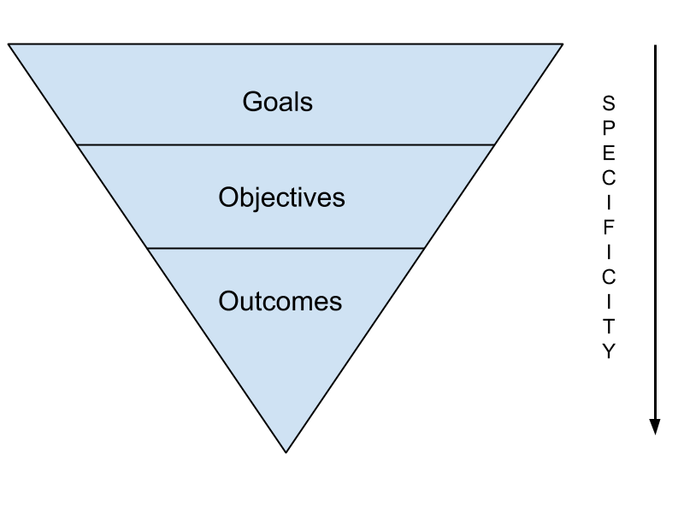
What are Learning Outcomes?
Engagement with community and engagement with community issues
Youth will review the components of a community needs assessment
Youth will engage in civic involvement by creating a community service action plan utilizing a needs assessment,

Slide 8
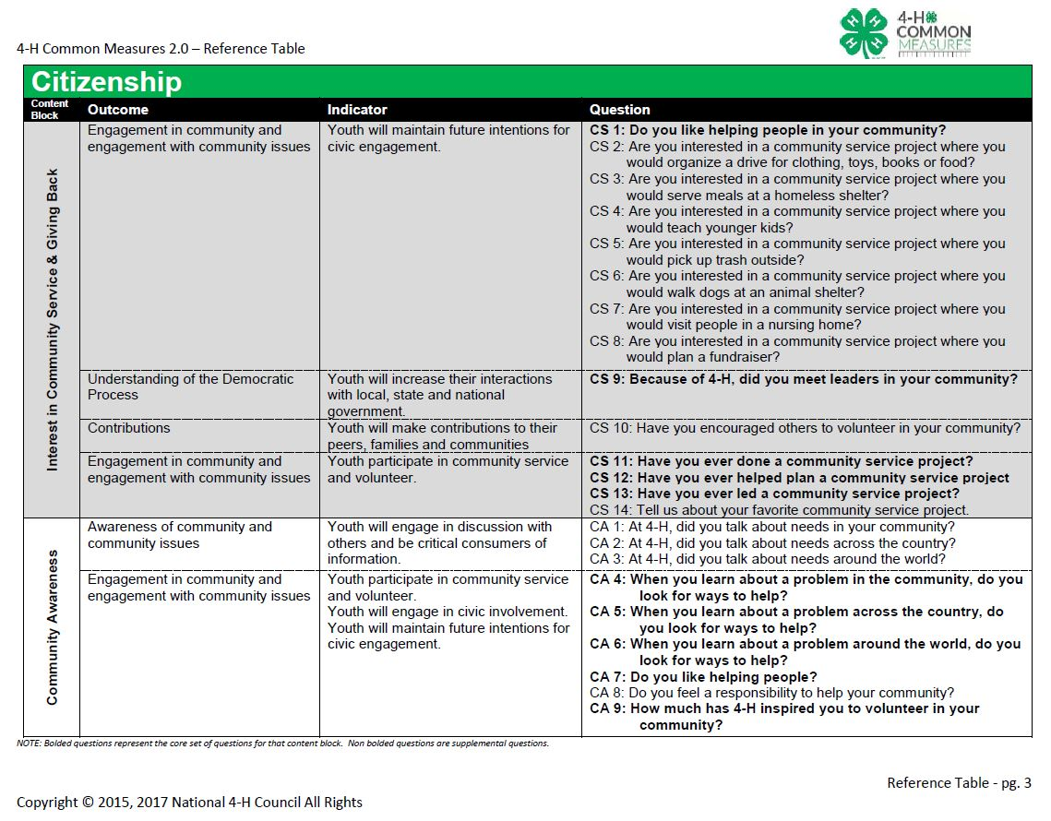
Goal
Outcome

Slide 9
Time for an ‘A-Ha! Moment’… Give it a try!
Choose food consistent with the Dietary Guidelines
Youth will…
Youth will consume healthy foods by learning….
Goal
Outcome

Slide 10
Time for an ‘A-Ha! Moment’… Give it a try!
Choose food consistent with the Dietary Guidelines
Youth will research the content on the MyPlate.gov website to identify components of a healthy diet
Youth will consume healthy foods by learning to construct a weekly meal plan for their family
Goal
Outcome

Slide 11
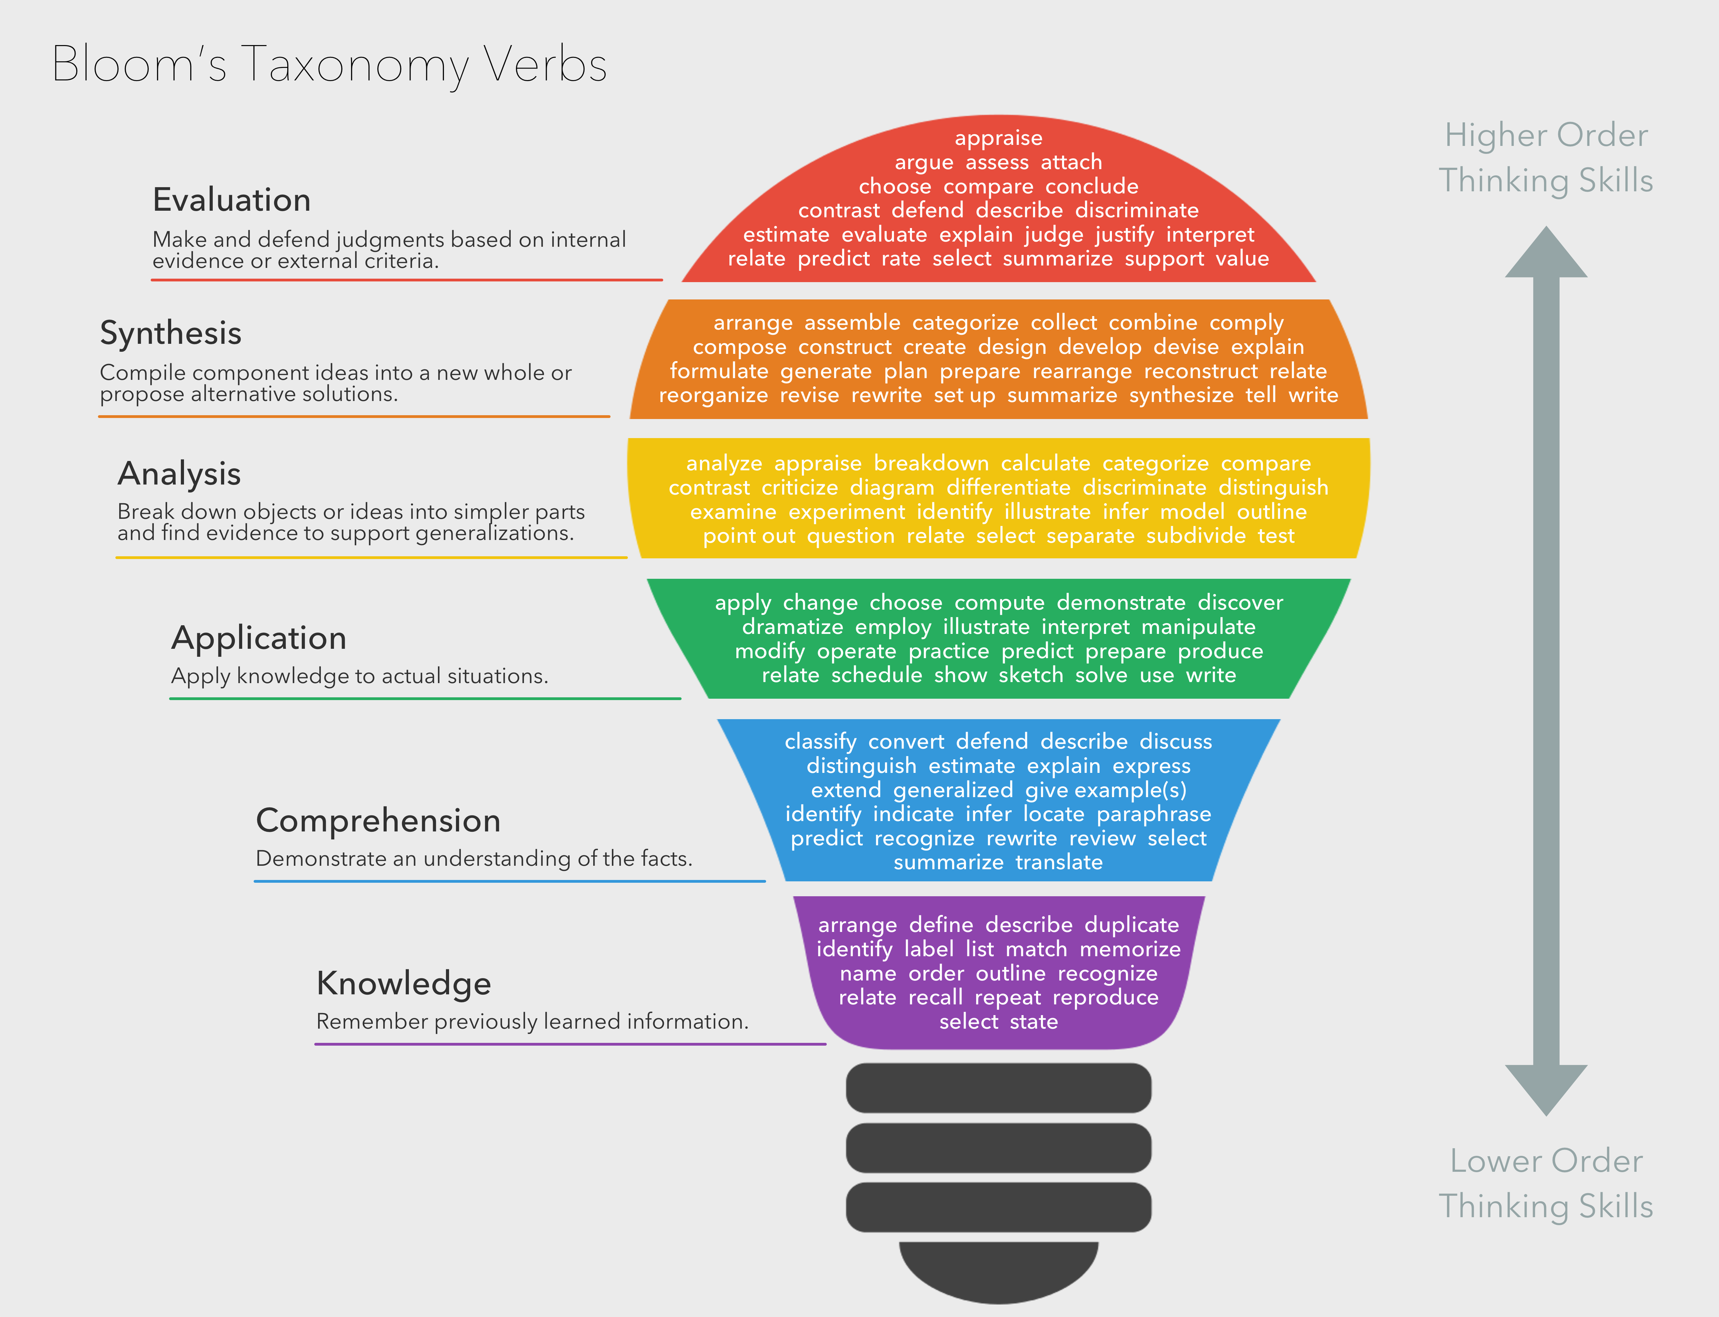
“Arin, how do you know what descriptors to use?”

Slide 12
Time for an ‘A-Ha! Moment’… So soon?
Think of an educational program you want to create…
Using the resources provided
-CM 2.0 Reference Tables
-Bloom’s Verbs
1. Choose your overarching Goals
2. Identify your educational content Objectives
3. Define youth learning Outcomes

Slide 13
Now We’ve Created Our Educational Programming…
Planning your assessment…
Depends on what your goals are and what you want to know.
1. Snapshot
2. Story
3. Metamorphosis
Engagement with community and engagement with community issues
Youth will review the components of a community needs assessment
Youth will engage in civic involvement by creating a community service action plan utilizing a needs assessment,

Slide 14
Now We’ve Created Our Educational Programming…
Planning your assessment…
Depends on what your goals are and what you want to know.
Snapshot
-Interested in a single point in time
-New program
-New topic
-Plan to provide survey once for a single 6-hour program
Engagement with community and engagement with community issues
Youth will review the components of a community needs assessment
Youth will engage in civic involvement by creating a community service action plan utilizing a needs assessment,

Slide 15
Now We’ve Created Our Educational Programming…
Planning your assessment…
Depends on what your goals are and what you want to know.
2. Story
-Interested in how a series of programs/workshops impacts youth
-Area specific (Science, Citizenship, Healthy Living, etc.)
-Cumulative Effect
-Plan to provide survey once at the end of a series of workshops
Engagement with community and engagement with community issues
Youth will review the components of a community needs assessment
Youth will engage in civic involvement by creating a community service action plan utilizing a needs assessment,

Slide 16
Now We’ve Created Our Educational Programming…
Planning your assessment…
Depends on what your goals are and what you want to know.
3. Metamorphosis
-Interested in how youth attitudes, beliefs, and values shift
-Community needs assessment
-Educational program goals use content to teach social skills, mind
set, eight essential elements
-Plan to provide survey pre and post
Engagement with community and engagement with community issues
Youth will review the components of a community needs assessment
Youth will engage in civic involvement by creating a community service action plan utilizing a needs assessment,

Slide 17
Time for an ‘A-Ha! Moment’
Remember that educational program you just created…
What are your goals and what do you want to know.
1. Snapshot
2. Story
3. Metamorphosis
What influenced your decision?

Slide 18
Now We’ve Created Our Educational Programming…
Review:
Learning Outcome
Learning Objective
Program Goal
Goal
Outcome
What are your goals and what do you want to know.
1. Snapshot
2. Story
3. Metamorphosis

Slide 19
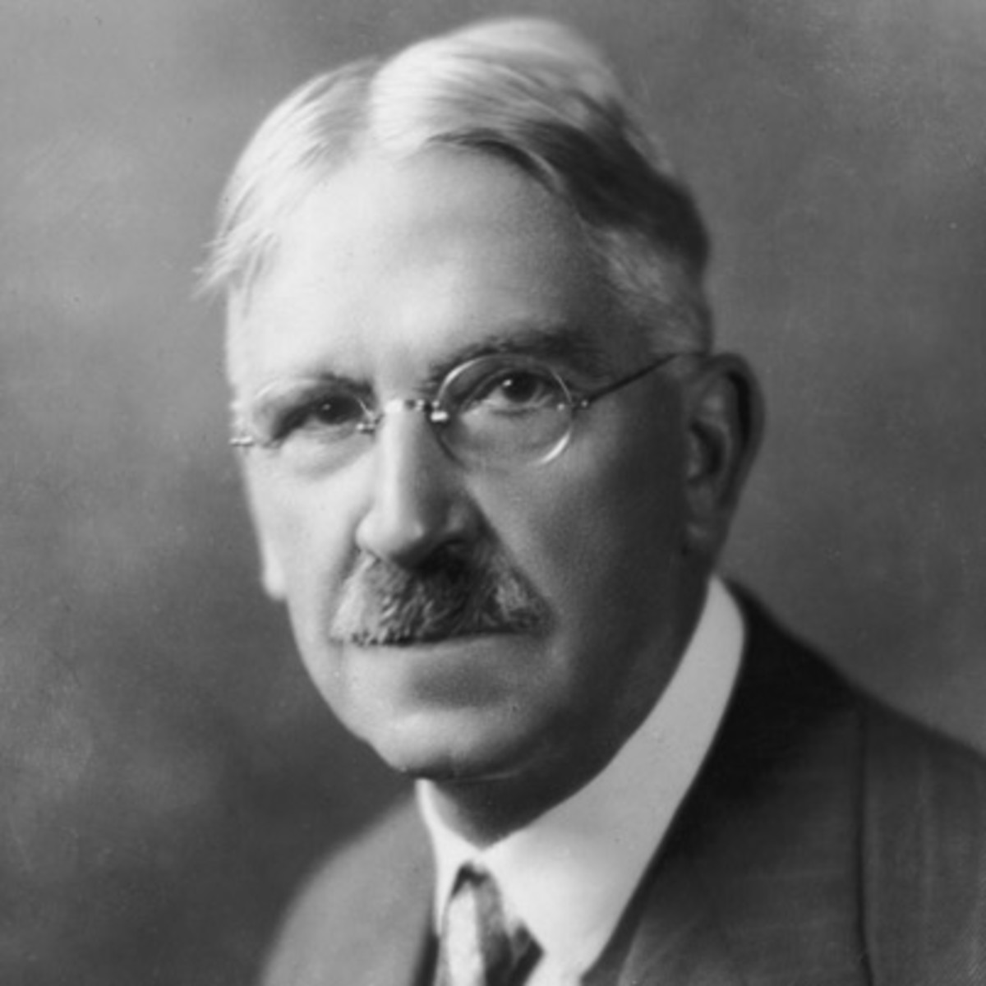
One Final Thought
“Arriving at one goal is the starting point to another.” ― John Dewey, Democracy and Education

Slide 20
Time for a Final ‘A-Ha! Moment’…
What’s one new thing you learned today?
What’s one new thing you’re ready to try?
What’s one thing you’re still unsure of?

Slide 21
Official Transition Date for Common Measures 2.0:
January 1st, 2018
**Continue to use 1.0 for your Digital Measures Impact Statements and Reporting until official transition date**

Slide 22
Your feedback is valuable
Next Webinar…
That depends on you ☺
http://purdue.ag/WebinarFeedback
Thank You

