Slide 1


Ecology of
INVASIVE Species
Ann Kline, ANR Extension Educator

Slide 2




What makes something an invasive species?
living
Notes:
Alive / Living
In a place they don’t originally belong – talk about what ‘native’ means; share ways invasives get here
Cause Harm – discuss how harm can be caused: environmental, economic, health
Using these parameters, assess whether these are an invasive species
(Ask ‘what is the state flower?’) Peony:
Alive
In a place (Indiana) they doesn’t originally belong
But they DON’T cause harm
→ not invasive specie
Another example: Kindergarteners in this classroom:
Alive
In a place they don’t belong
Do they cause harm (subjective – students will have differing opinions)

Slide 3




Kinds of invasive species
plants
animals
diseases
insects
Notes:
Interact with students and see how many of these they can name.

Slide 4

plants

Slide 5
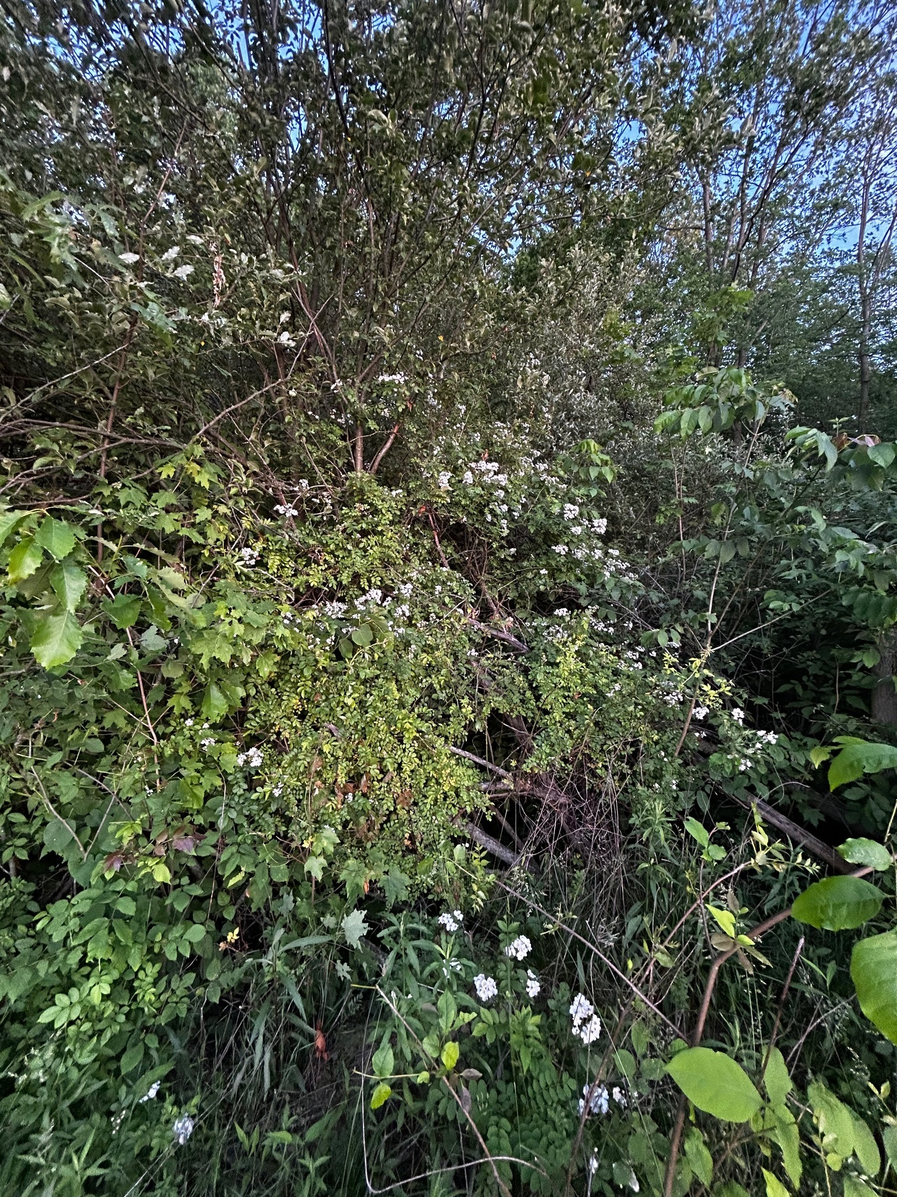
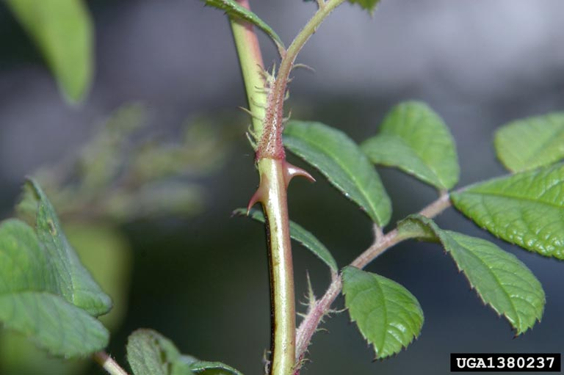
Multiflora rose
Chris Evans, University of Illinois, Bugwood.org
Photo credit: Ann Kline
Rob Routledge, Sault College, Bugwood.org
Notes:
WHY a problem:
Grows and spreads aggressively by producing high numbers of viable seeds that are consumed by birds or small mammals and distributed to new areas
Arching stems can root when they tough the ground
Vigorous growth, rapid spread outcompetes natives,
Thorny stems tangle and make impenetrable thickets hard for humans and livestock to navigate
HOW they got here:
Introduced as a rootstock for ornamental roses
Also used for erosion control, living fence rows and wildlife habitat
WHAT can we do?
Remove it on your property

Slide 6
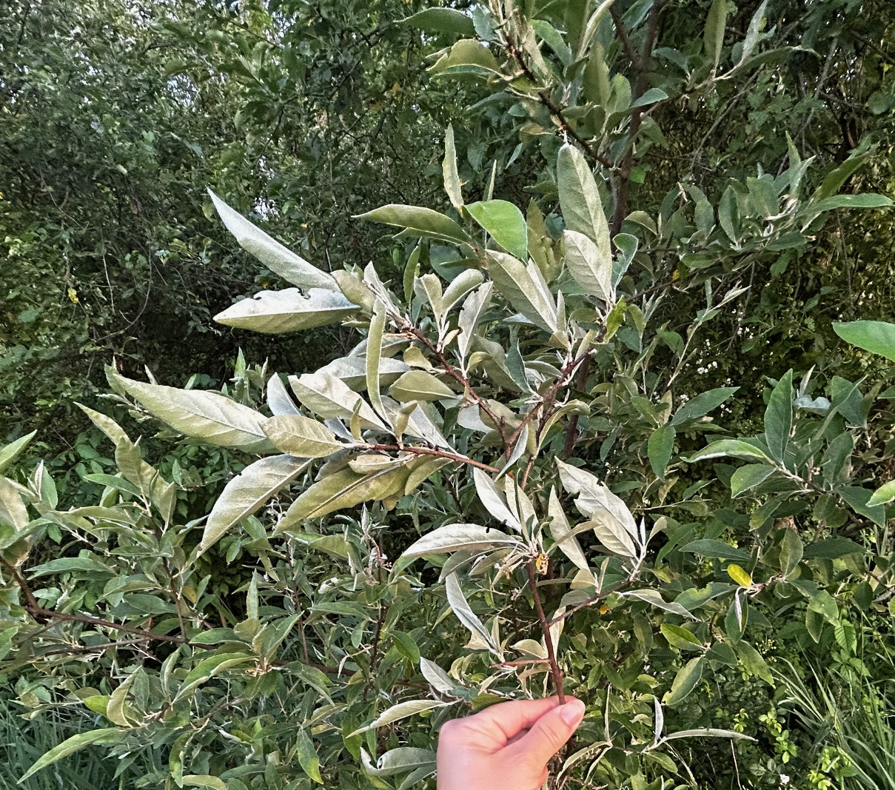
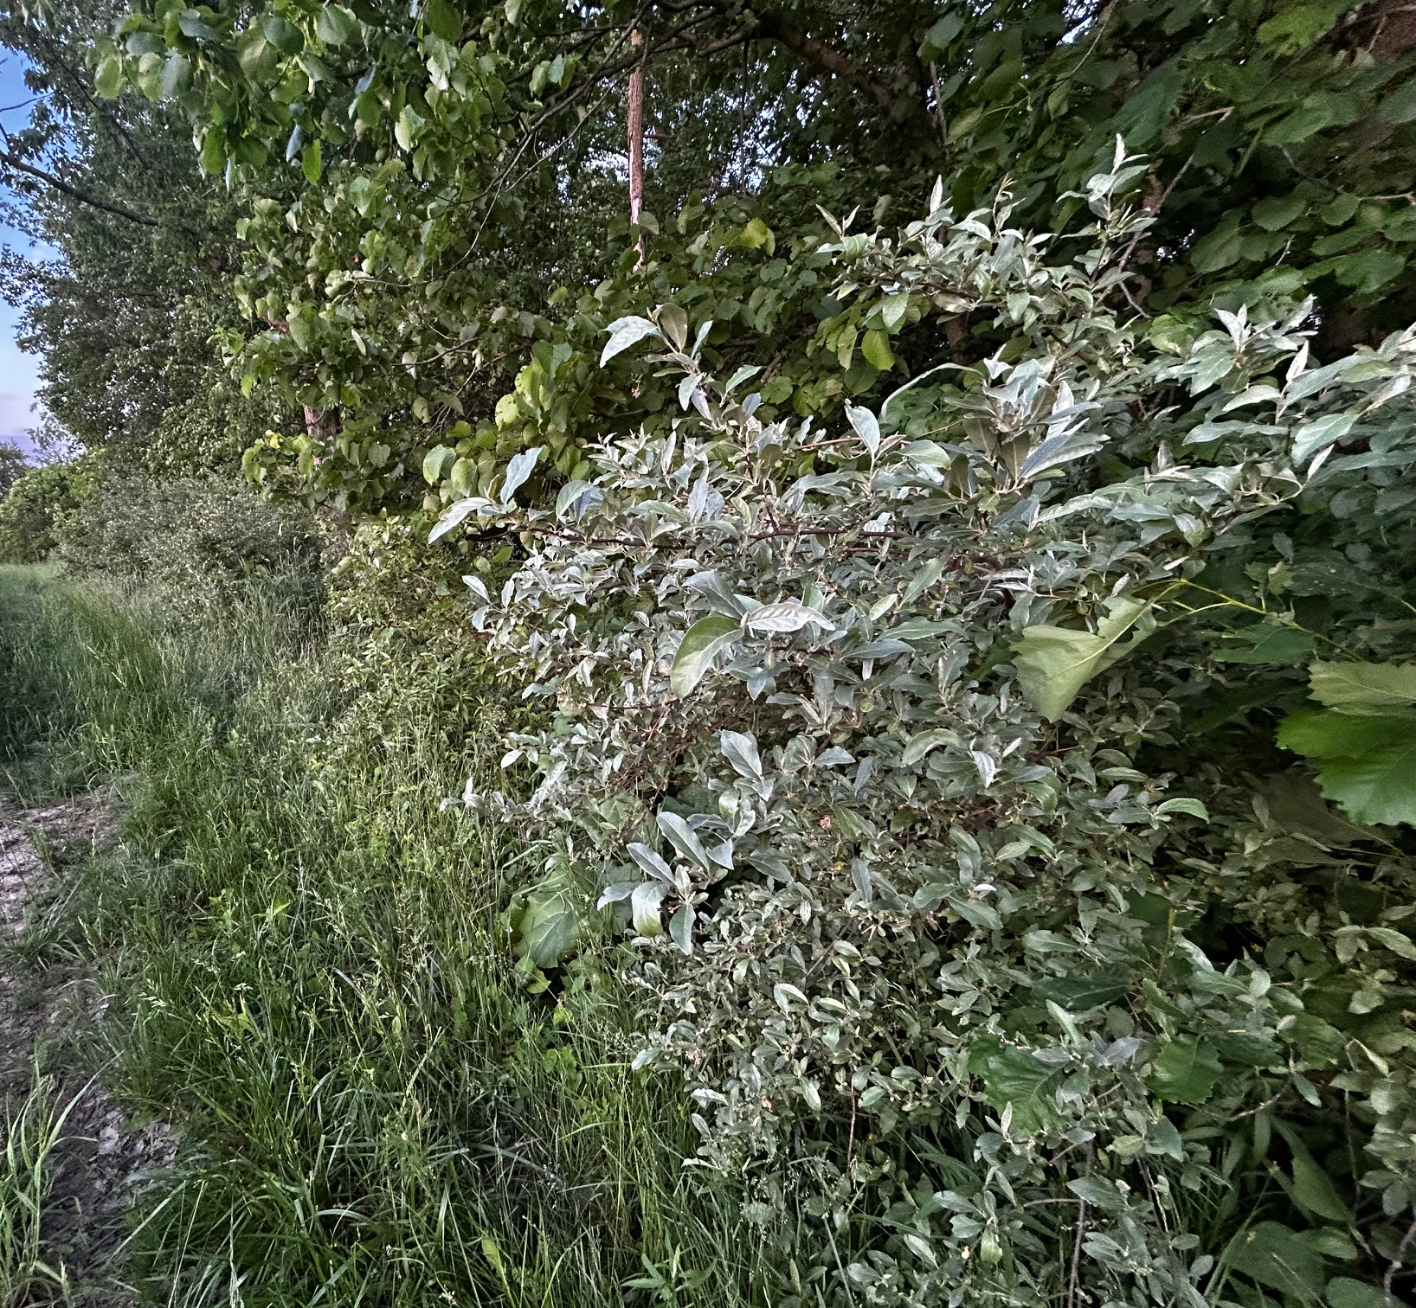
Autumn olive
Chris Evans, University of Illinois, Bugwood.org
Photo credits: Ann Kline
Notes:
WHY a problem:
displaces native plants by creating dense shade, altering soil chemistry, and interfering with natural plant succession
produces large amount of seeds with a high germination rate
seeds dispersed by birds and mammals
Regrows easily when cut
HOW they got here:
ornamental gardens, windbreaks, wildlife cover, and to restore soils degraded by deforestation and mining.
WHAT can we do?
Remove it on your property

Slide 7
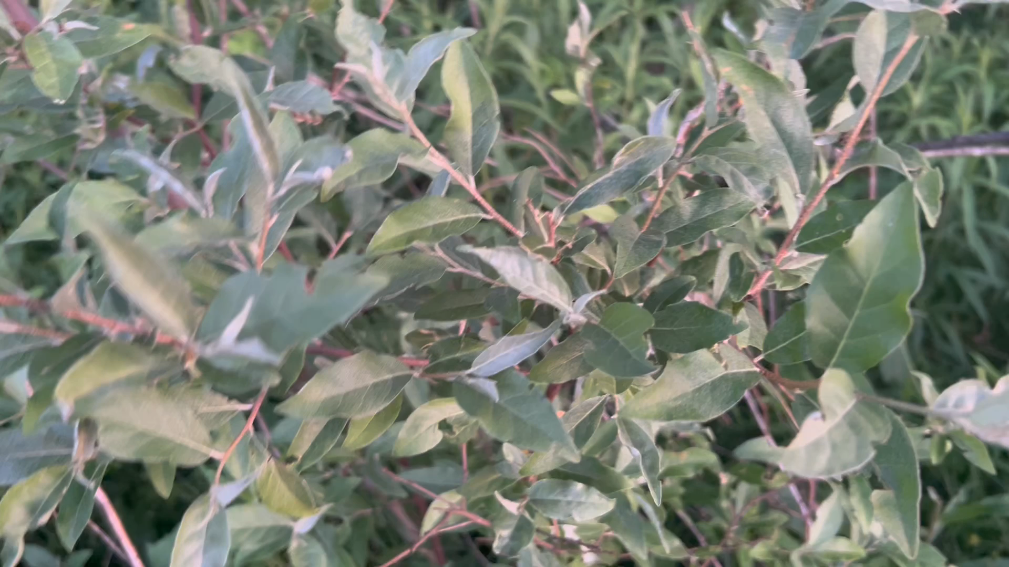
Autumn olive
Chris Evans, University of Illinois, Bugwood.org
Video credit: Ann Kline
Notes:
Silvery back of the leaf is a good identifier

Slide 8
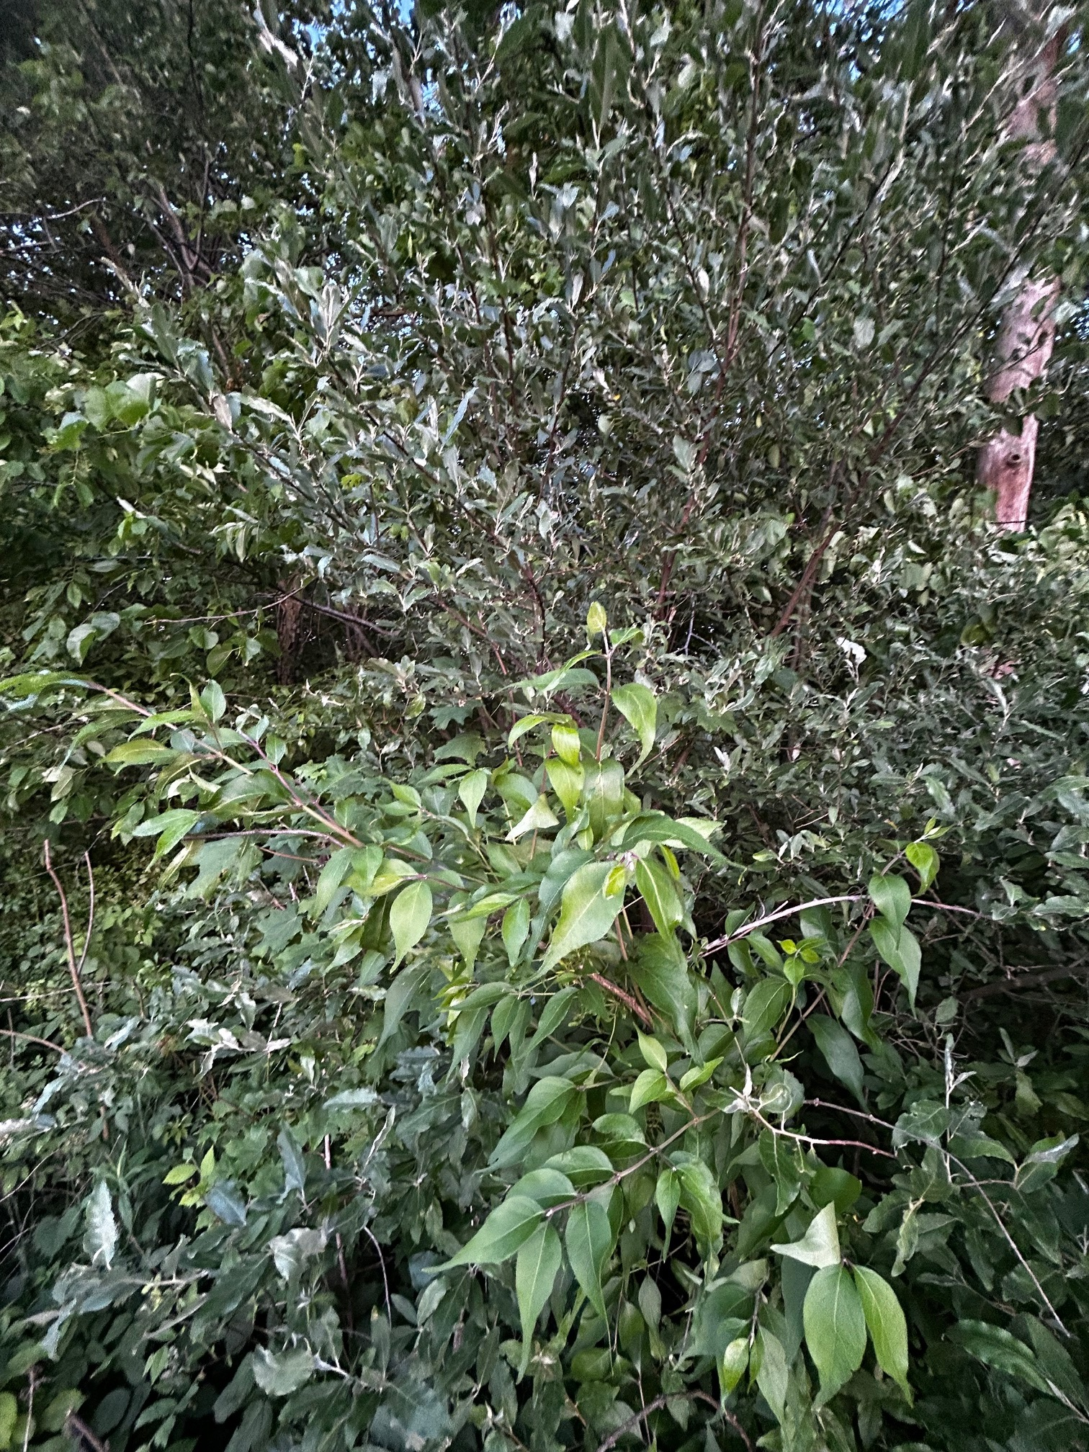
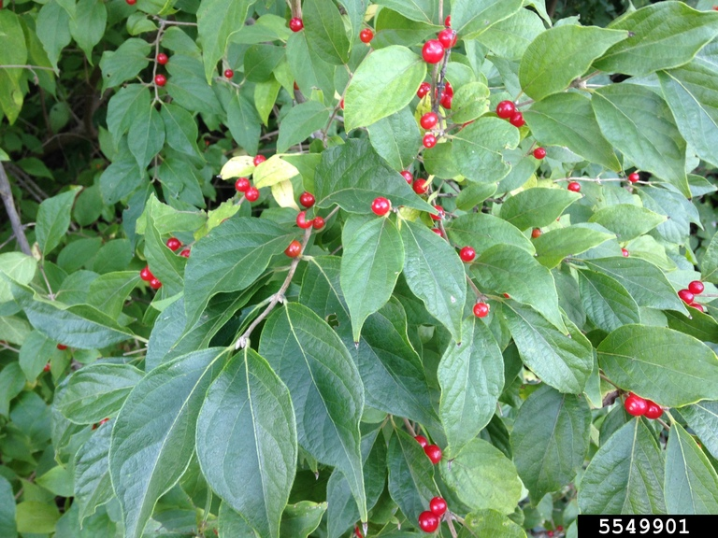
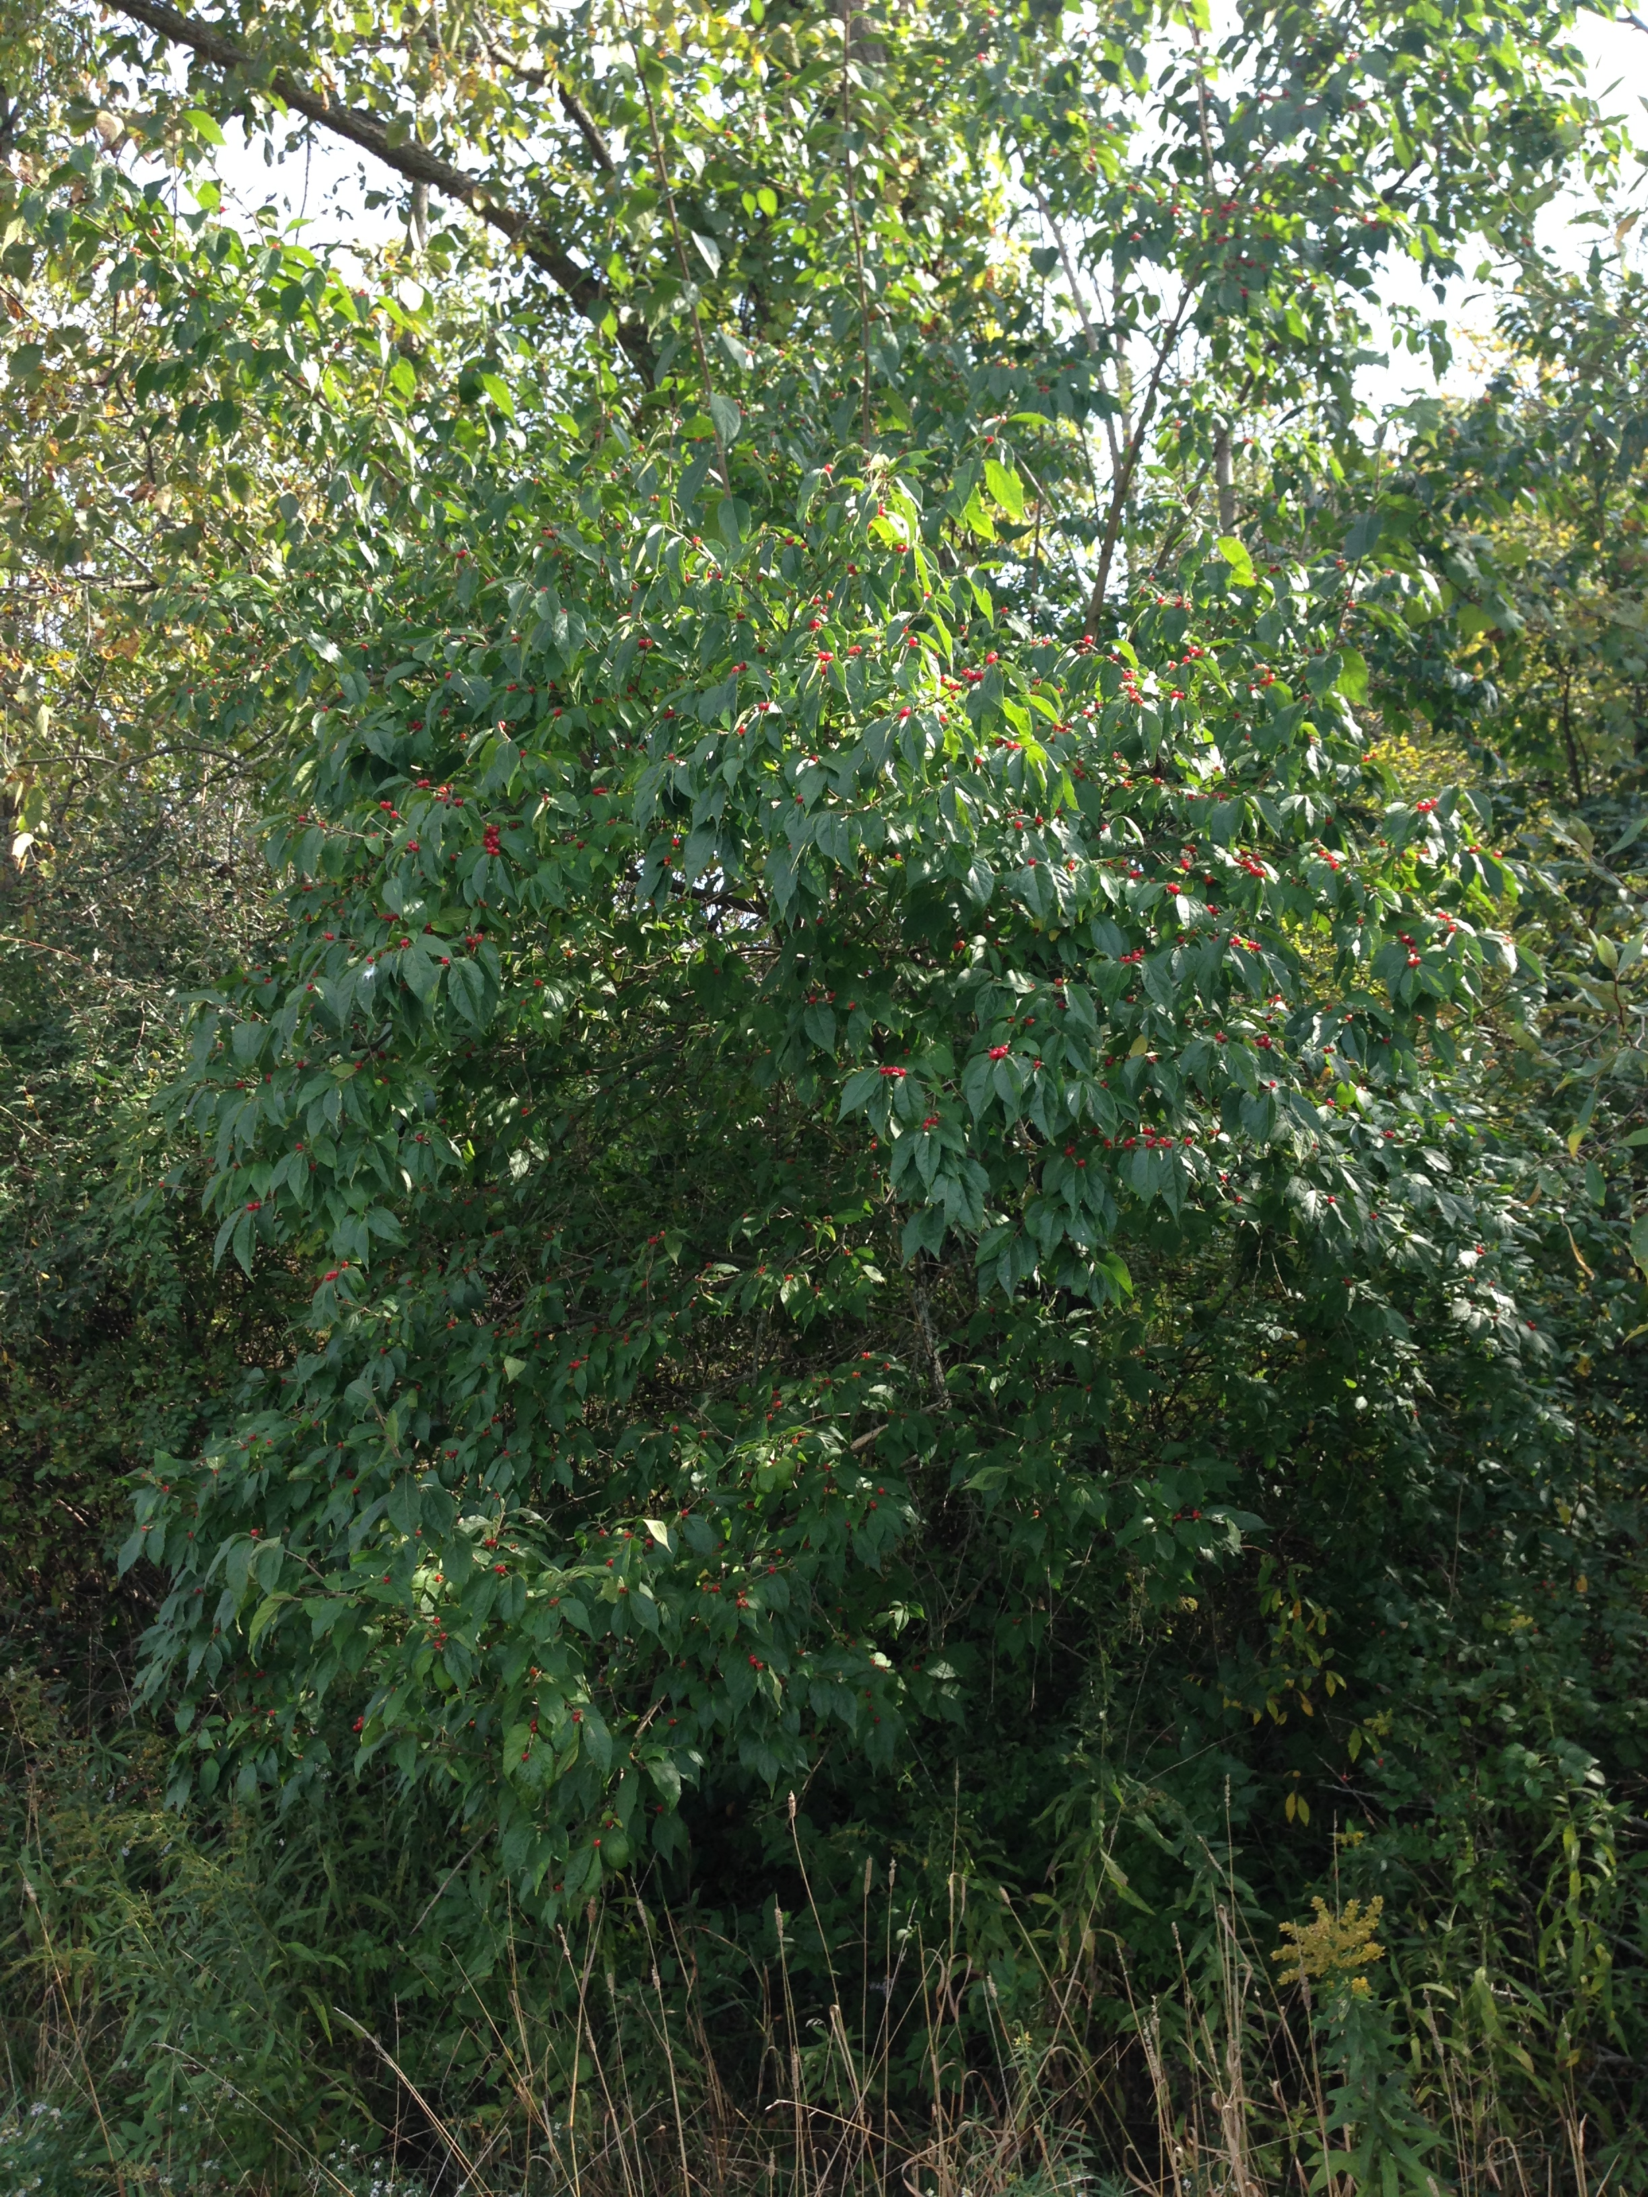
Asian Bush honeysuckle
Photo Credit: Ryan Armbrust, Kansas Forest Service, Bugwood.org
Honeysuckle growing under Autumn olive
Photo Credit: Ann Kline
Photo Credit: Ann Kline
Photo Credit: Ann Kline
Photo Credit: Ann Kline
Notes:
WHY a problem:
leaf out earlier and retain leaves longer, competing with native species
Allelopathic exudates
limits the amount of throughfall rain through the canopy; water from honeysuckle leaves has a cation concentration up to 3 times greater
Honeysuckle alters the macroinvertebrate species makeup of aquatic environments
HOW they got here:
Cultivated as an ornamental plant
WHAT can we do?
Remove it on your property
Think carefully about what plants you add to your landscape; consider natives

Slide 9
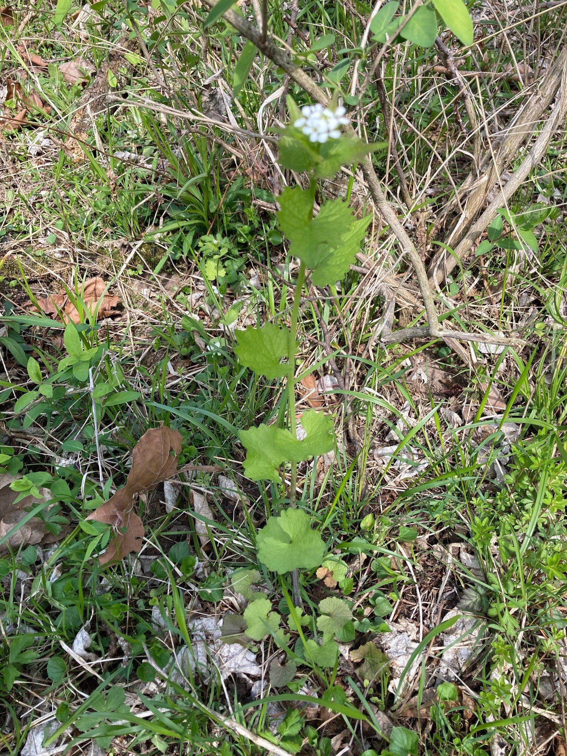
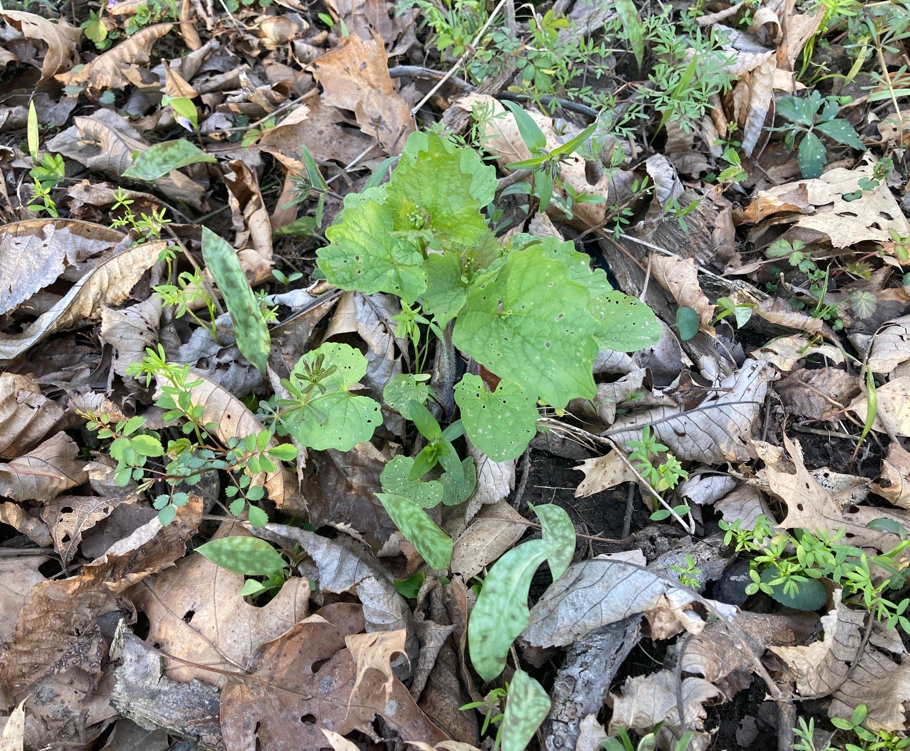
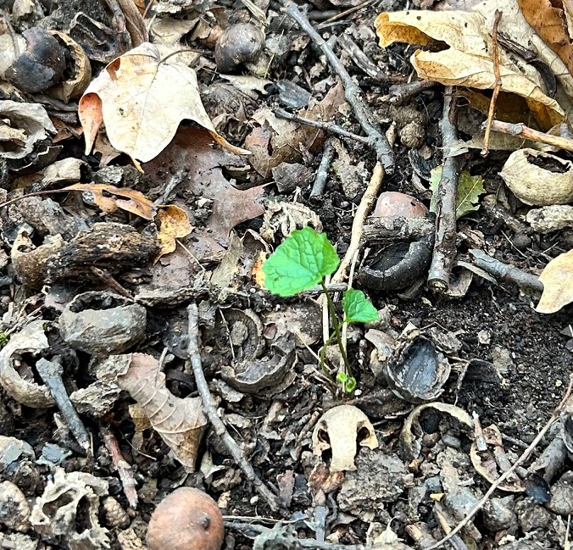
Garlic mustard
Photo credit: Ann Kline
Photo credit: Ann Kline
Notes:
Is a biennial
WHY a problem:
Allelopathic
Controlling light, water, and nutrient resources in forest understories and outcompetes natives
HOW they got here:
Likely brought intentionally as herb and medicinal plant – before 1868
WHAT can we do?
Remove it on your property
Eat it!
Picture 3: From late November 2025 – found under leaves when deer hunting

Slide 10
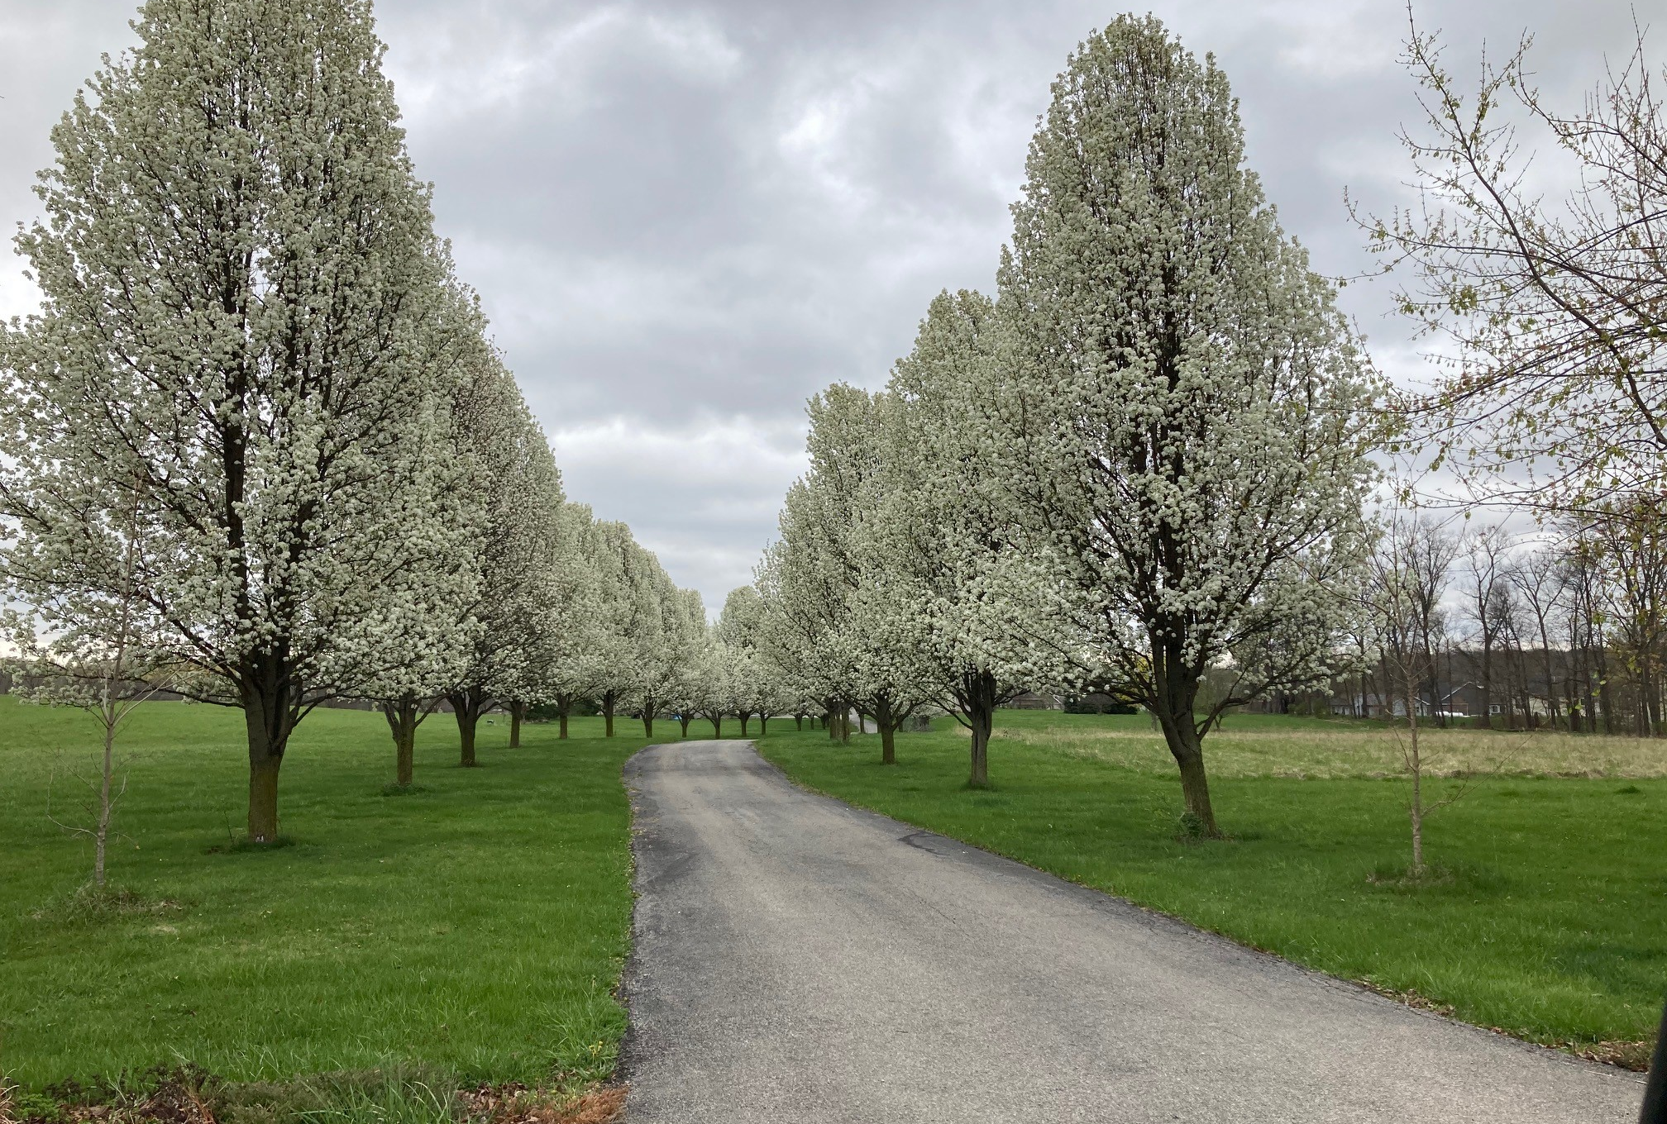
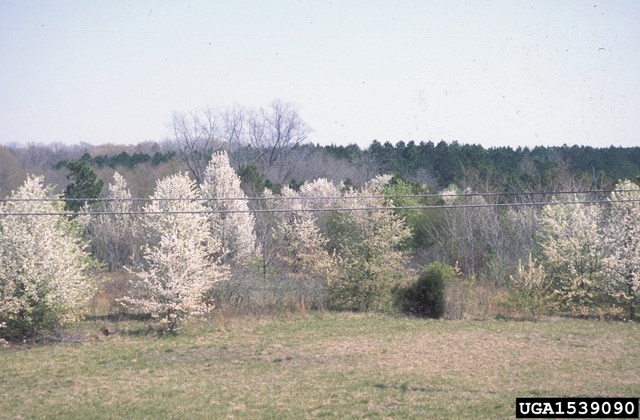
Callery pear
Photo Credit: Ann Kline
Photo credit: James H. Miller, USDA Forest Service, Bugwood.org
Notes:
WHY a problem:
Reproduces quickly – produces many seeds dispersed by birds and more
Can spread
Lack of natural control
Dense thickets outcompete native species that do not tolerate shade
Compete with natives for water and space
HOW they got here:
1916 by the U.S. Department of Agriculture for development of fire blight resistance in the common pear (Pyrus communis), which was devastating the commercial pear industry. It was widely planted as a rootstock for common pear long before it gained interest as an ornamental. Around 1950, the ornamental value and hardiness of Callery pear were recognized, leading to the development of a number of cultivars, including ‘Bradford.’
WHAT can we do?
Remove it on your property
Think carefully about what plants you add to your landscape; consider natives

Slide 11
animals

Slide 12
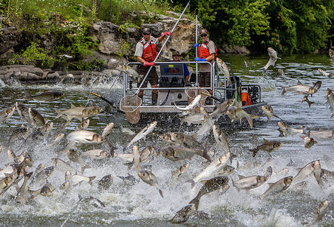
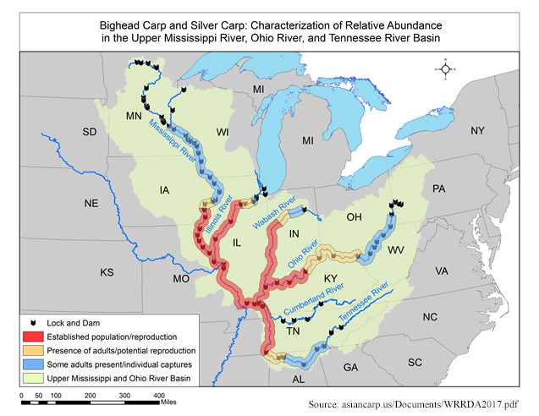
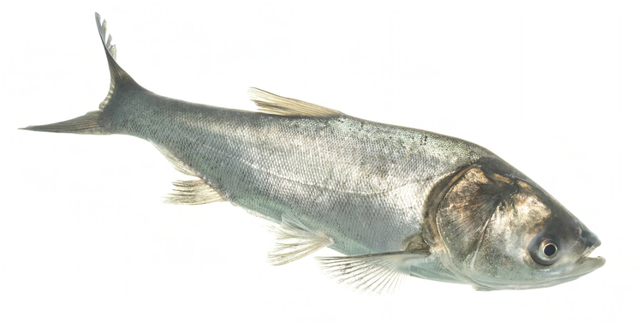
Invasive carp
Pictures from USGS
Notes:
Carp: native to Europe and Asia. Common carp have been in US >100 years. Bighead, black, grass, and silver carp are invasive carp species.
WHY a problem?
threaten imperiled species
reduce game fish populations: invasive carp reproduce quickly, devastating the number and health of other fish
threaten human health: silver carp often jump out of the water when disturbed by boat motors, damaging boats and potentially harming passengers
negatively impact native species: adult bighead or silver carp can eat up to 40% of their body weight daily; they can drastically change a body of water’s food chain and displace other species
HOW they got here: Imported to southern US to help keep aquaculture and wastewater treatment facilities’ retention ponds clean. Escape due to flooding and accidental releases - into the Mississippi River system, migrating to the Ohio, White, and Wabash rivers.
WHAT can we do?
Never move fish from one body of water into another
Drain live wells before leaving site - eggs might be floating in the water
Put unused live bait in trash instead of the water. Young invasive carp resemble other common baitfish and might invade your bait bucket.
BOUNTY for carp in Indiana - https://www.in.gov/dnr/fish-and-wildlife/fishing/aquatic-invasive-species-ais/black-carp/
https://fox2now.com/news/national/you-could-get-paid-for-catching-these-fish-species/?fbclid=IwQ0xDSwMHcYJjbGNrAwdmr2V4dG4DYWVtAjExAAEeGpESU9gd4Ys0e61OQHXIbMr2lBhJusQC7RaNzgC8h7UPlS5NLP4bGEqSZAA_aem_NrlGNRok3aXny6O4rxIe0w

Slide 13
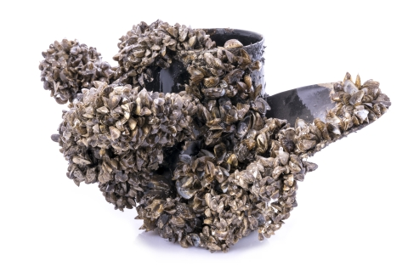
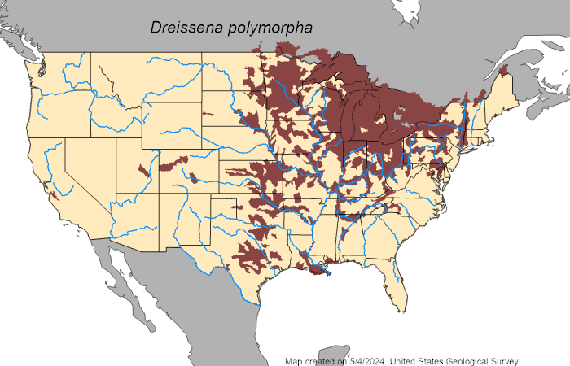
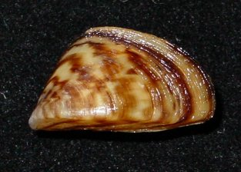
Zebra mussel
Pictures from USGS and US Fish & Wildlife Service
Notes:
WHY a problem:
Constrict flow in pipes reducing intake (affects fire fighting equipment) Pipe diameters reduced by two-thirds at water treatment facilities.
Small ones get into engine cooling systems: overheating and damage.
Navigational buoys have been sunk under the weight
Ecosystem: reduced the biomass of phytoplankton, diatoms, algae, etc.
HOW they got here:
Likely ballast exchange of a cargo ship from Black Sea to the Great Lakes, which then spread through passive drifting of larva and its ability to attach to boats navigating these lakes and rivers. They can live in the gut of fish! Have been found attached to imported alga in aquarium/pet stores in 29 states.
WHAT can we do?
Inspect recreational boats disperses between bodies of water
Never move fish from one body of water into another
Drain live wells before leaving site - eggs might be floating in the water
Don’t dump water from aquariums into bodies of water

Slide 14
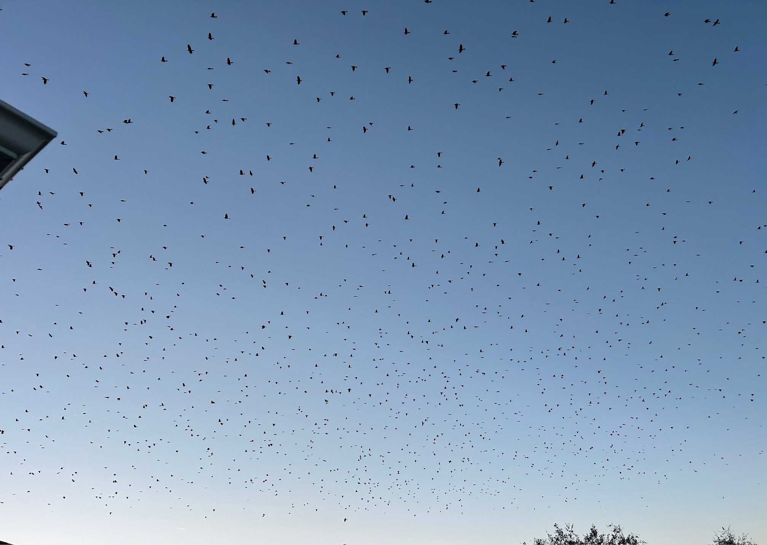
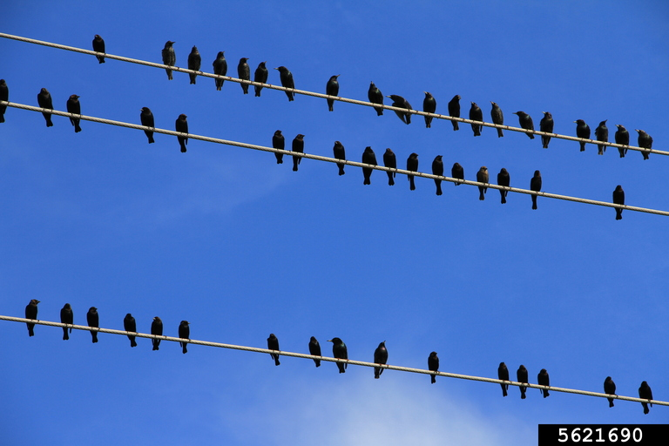
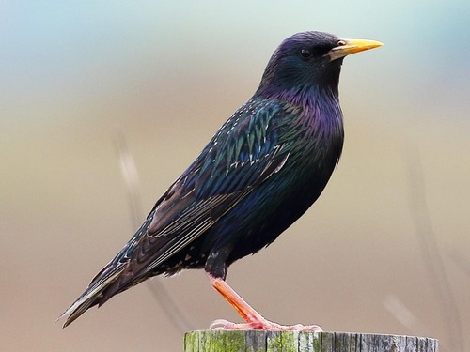
European starling
Photo credit: Macaulay Library, CLO, Dan Vickers
Photo Credit: Gerald Holmes, Strawberry Center, Cal Poly San Luis Obispo, Bugwood.org
Photo Credit: Ann Kline
Notes:
WHY a problem:
compete with native species: take nesting sites
eat cattle rations and destroy fruit and grain crops
Reproduce quickly
May carry diseases of birds, livestock, and even humans
HOW they got here:
Shakespeare enthusiasts wanted to have all species of birds from Shakespeare’s works in the US and released around 100 birds in Central Park in 1890
WHAT can we do?
In past, some places had bounties (3 cents per bird)

Slide 15
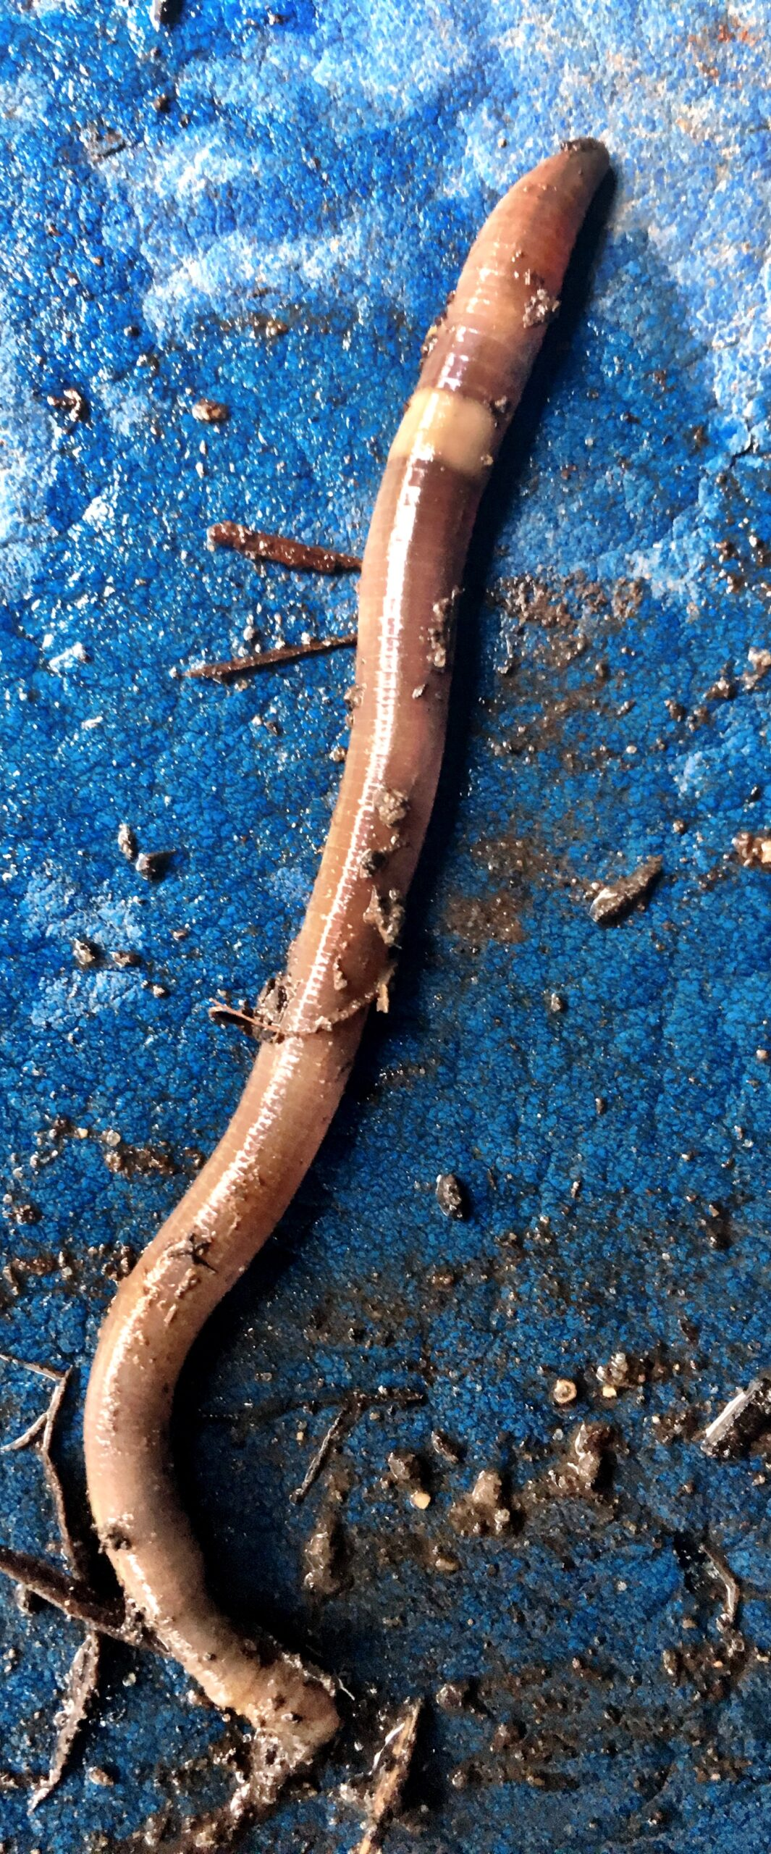
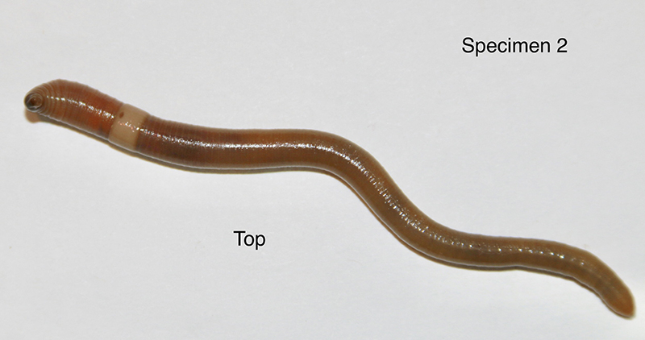
Asian Jumping worm
Photo Credits: Purdue Ag Communications
Notes:
WHY a problem:
Can transform soil into dry, granular pellets with a texture similar to discarded coffee grounds; altered soil structure unaccommodating to desired plants
Deplete soil of nutrients and impact soil organisms
Sometimes invasive plants thrive where jumping worms live
Can harm forests by changing soil and forest floor vegetation, which impacts ecosystem
HOW they got here:
Likely in imported plants
WHAT can we do?
Prevention is key; be careful not to introduce them to uninfested areas
Watch for them
Purchase only landscape or gardening material free of jumping worms
Purchase only compost and mulch heated to appropriate temps
Note – all earthworms are non-native, but these are harmful.
https://extension.entm.purdue.edu/publications/E-278/E-278.html
https://purduelandscapereport.org/wp-content/uploads/2020/06/Asian-jumping-worms-ID-impact-and-prevention.pdf

Slide 16
diseases

Slide 17
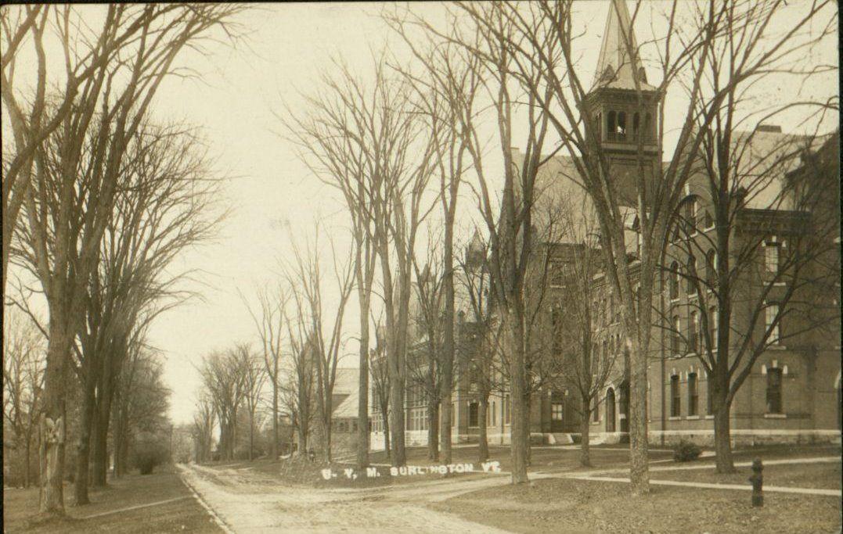
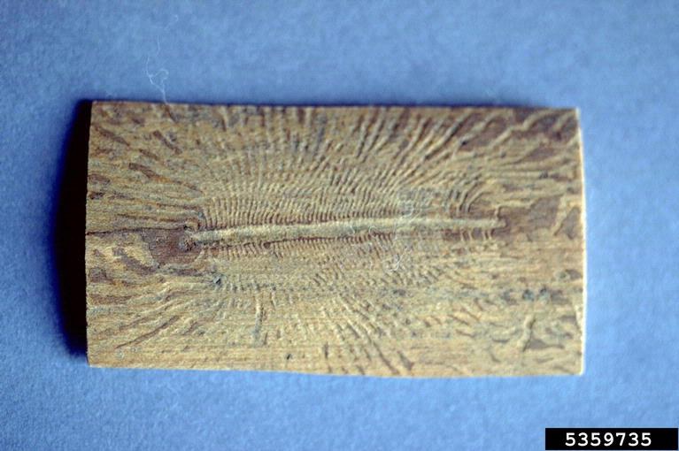
Dutch elm disease
William M. Brown Jr., Bugwood.org
“American elm - Dutch elm disease,” Omeka@CTL, accessed May 18, 2024, https://libraryexhibits.uvm.edu/omeka/items/show/1236.
William M. Brown Jr., Bugwood.org
Notes:
WHY a problem:
Ceratocystis ulmi (fungus) causes wilt and death in native elm species
Picture: Portion of elm wood afflicted with Dutch elm disease showing galleries created by the European elm bark beetle, which spreads the disease while feeding
HOW they got here:
Introduced accidentally on diseased logs imported from Europe
WHAT can we do?

Slide 18
insects

Slide 19
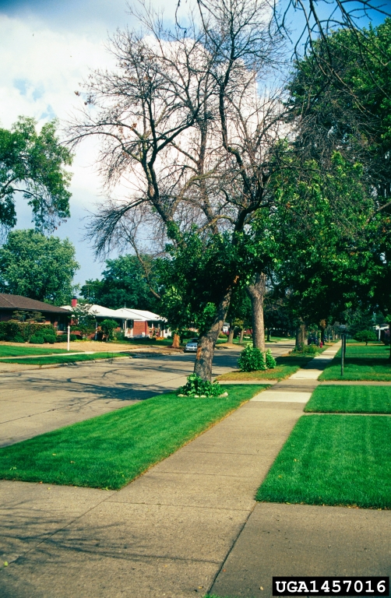
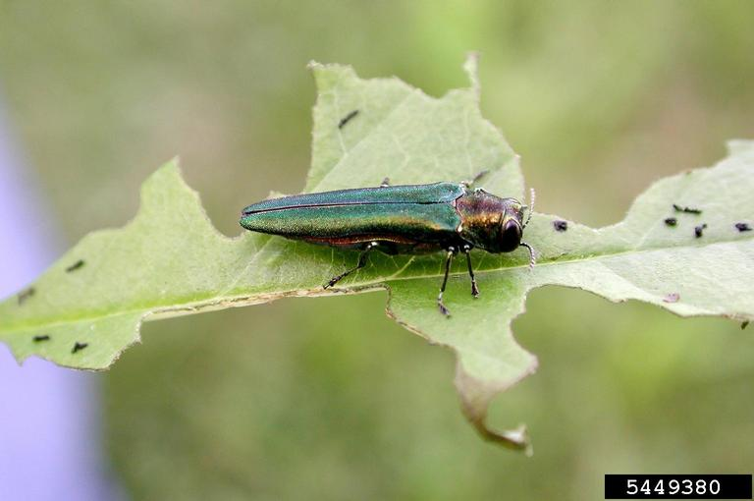
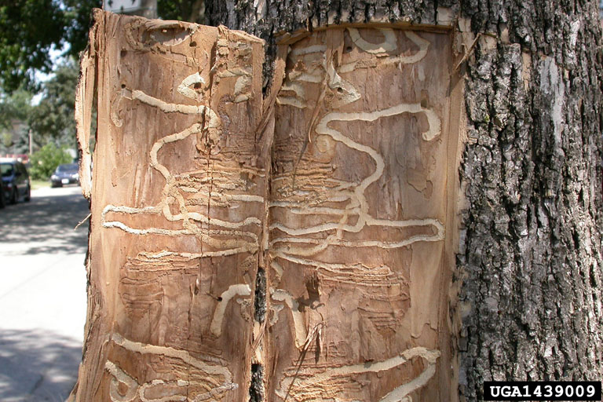
Emerald ash borer
Debbie Miller, USDA Forest Service, Bugwood.org
Edward Czerwinski, Ontario Ministry of Natural Resources, Bugwood.org
Steven Katovich, Bugwood.org
Notes:
WHY a problem:
Responsible for death and decline of millions of ash trees in N America
HOW they got here:
Likely came from shipping materials or pallets from cargo imported from Asia
First discovered in 2002
WHAT can we do?
Don’t move firewood

Slide 20
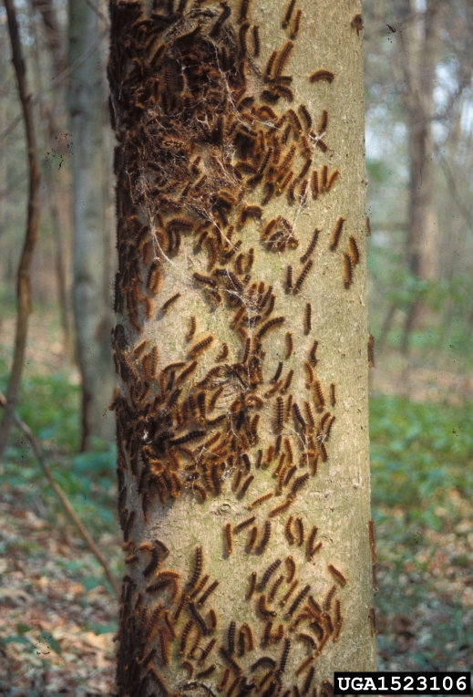
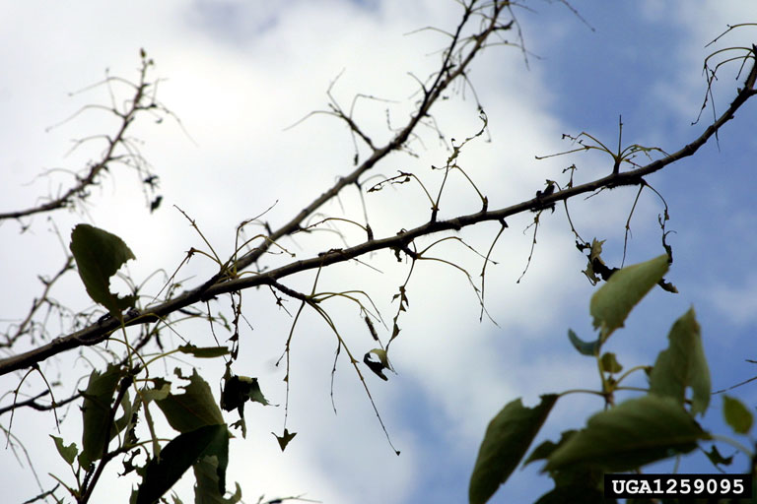
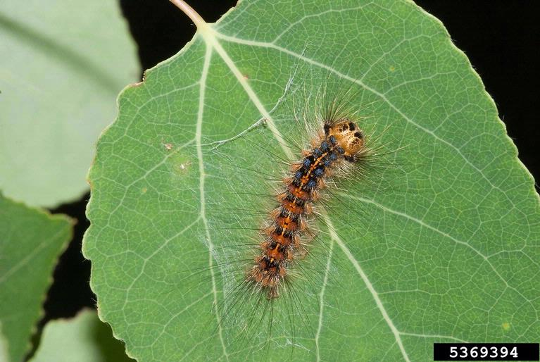
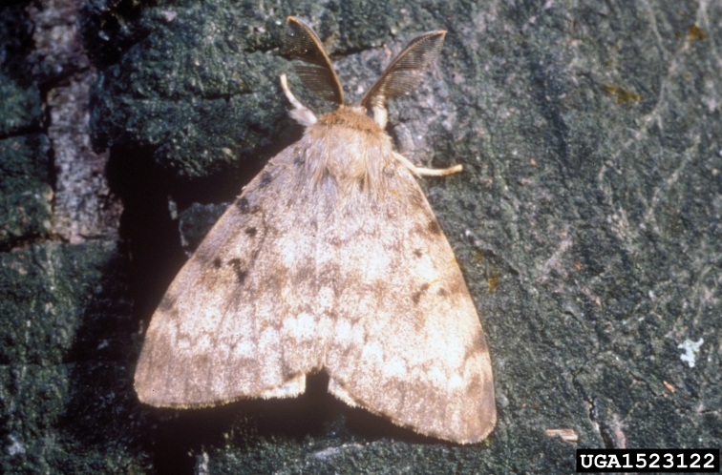
Spongy moth
Susan Ellis, Bugwood.org
Landesforstpräsidium Sachsen , Bugwood.org
Daniel Herms, The Ohio State University, Bugwood.org
Ferenc Lakatos, University of Sopron, Bugwood.org
Daniel Herms, The Ohio State University, Bugwood.org
Notes:
WHY a problem:
Feed on over 300 species of trees and shrubs
Can defoliate and eventually kill a tree
HOW they got here:
In 1860s, experiments were done in Boston to find a silk worm (traditional silk worm suffering from disease and war dampened cotton industry)
Researchers reared the insects and some escaped
WHAT can we do?
Before moving, look for egg masses laid on outdoor surfaces you will move
Before camping, look for egg masses on RVs, lawn furniture, toys, and more
Don’t move firewood

Slide 21
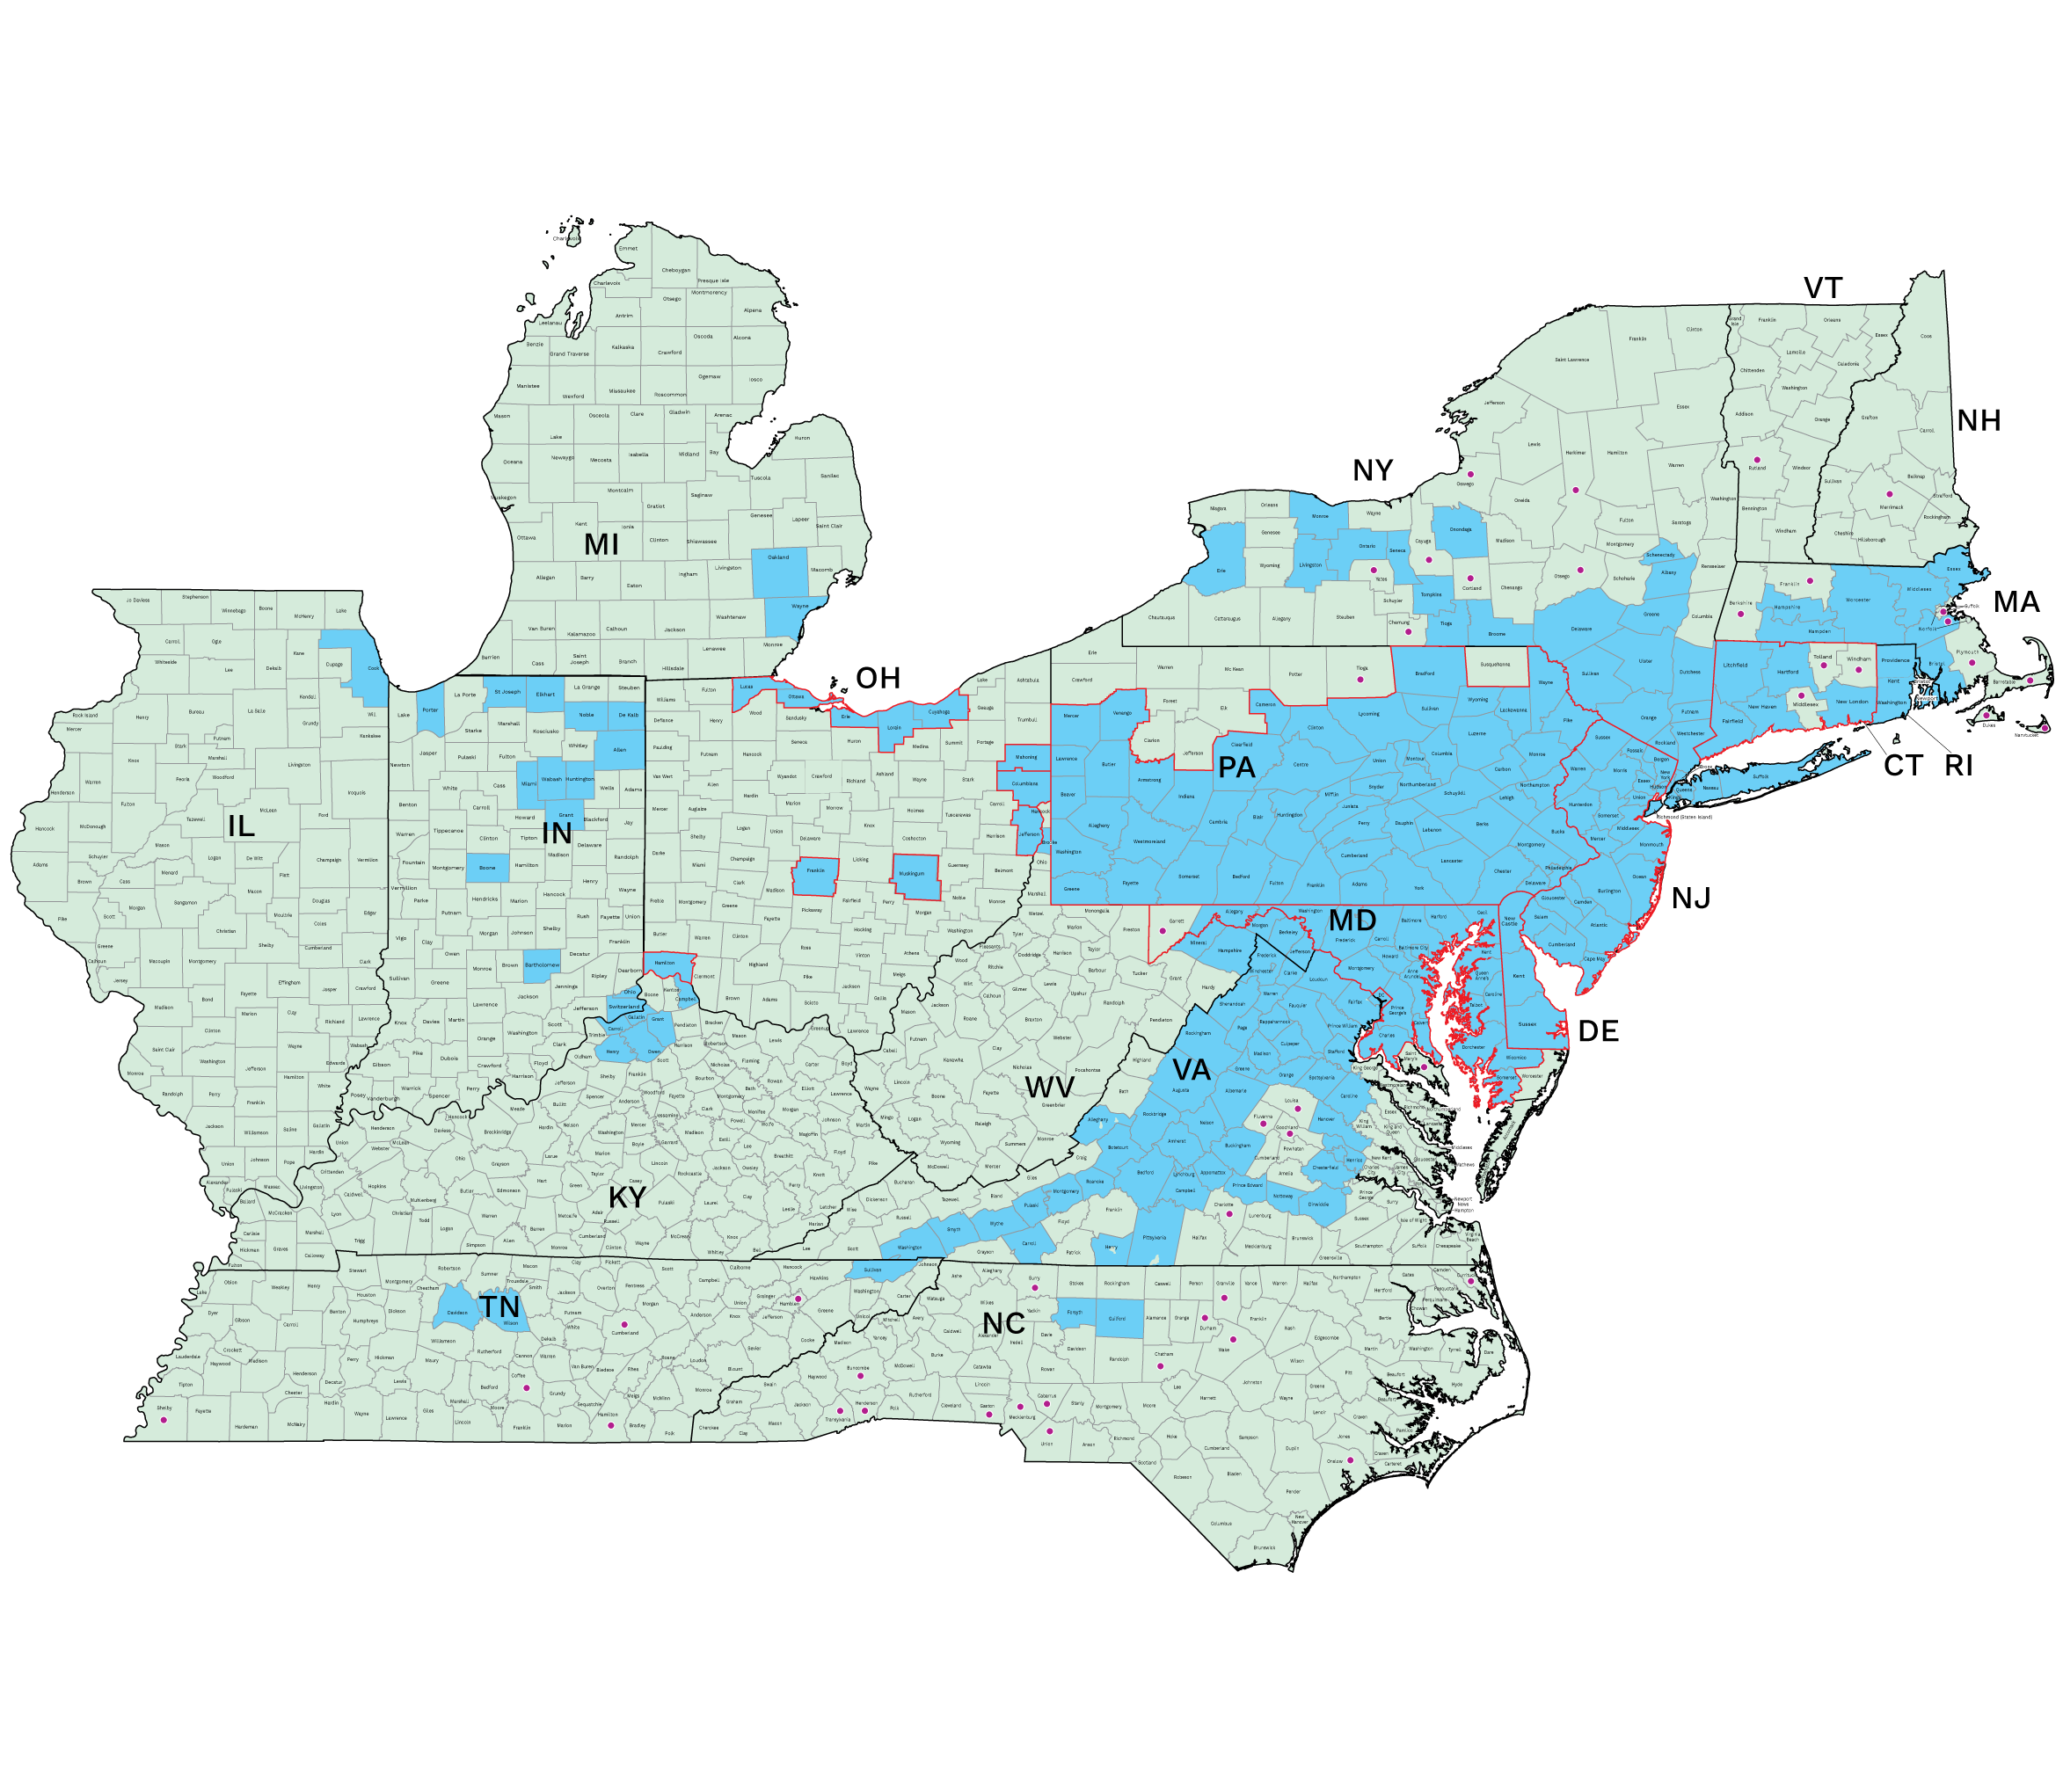
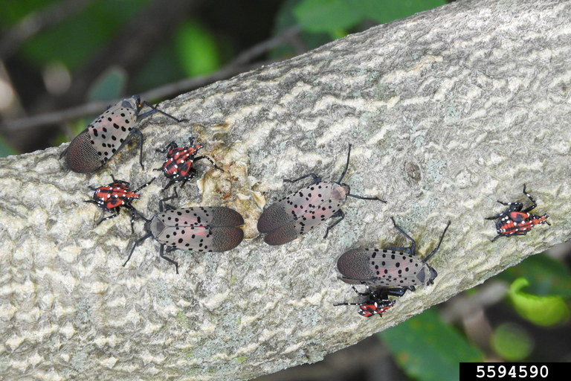
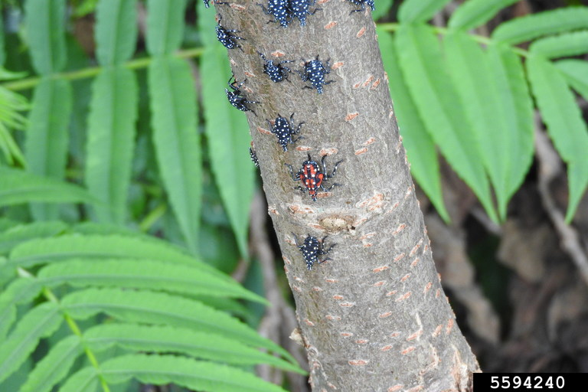
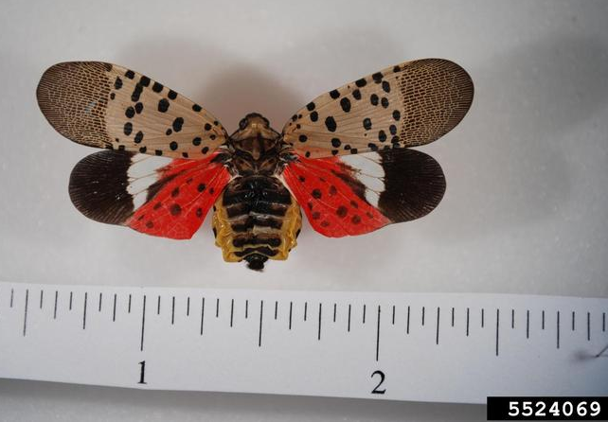
Spotted lanternfly
Richard Gardner, Bugwood.org
Richard Gardner, Bugwood.org
https://cals.cornell.edu/integrated-pest-management/
Pennsylvania Department of Agriculture , Bugwood.org
Notes:
WHY a problem:
Adults & nymphs feed on leaves, petioles, young shoots, branches and trunks of over 100 species (primarily woody species), resulting in oozing wounds on woody tissue and wilting and death of branches
Could have serious impact on the grape, orchard and logging industries in the US
HOW they got here:
Hitchhiking pest from imported goods.
First detected in the US in Pennsylvania in 2014. Identified in Switzerland County, IN (near the Ohio River) in 2021. Now found in Huntington, Elkhart, St. Joseph, Allen, and Porter counties.
WHAT can we do?
Look for it (The spotted lanternfly can be spread long distances by people who move infested material)

Slide 22

Simulation game
Plants
Insects
predators
Notes:
See separate instruction sheet

Slide 23
Evaluation
Notes:
See standard survey

Slide 25

Thank you
Ecology of Invasive Species lesson developed by Ann Kline​, kline60@purdue.edu

