Slide 1

Environmental Engineering
Burnett Creek
H₂Officers
Groundwater Detectives
Notes:
Ask them to hold general questions about the discipline until the end of the activity during the questions and answer session. The activity should be only 30 mins.

Slide 2
Environmental Engineering
A factory in Pawnee, IN has leaked barrels of Purdueium into the ground.
You work for an environmental engineering firm who was hired by Councilwoman Leslie Knope to assess & remediate the damage.
Notes:
Ask them to hold general questions about the discipline until the end of the activity during the questions and answer session. The activity should be only 30 mins.

Slide 3
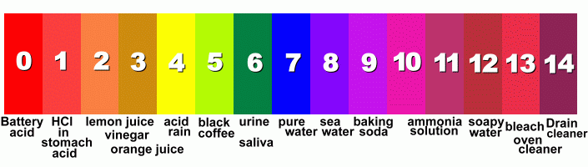
Environmental Engineering
Part 1:
  Determine where the contaminant is headed
  Purdueium has a low pH, so contaminated water will likely have a low pH
Acidic
Neutral
Basic
Notes:
Ask them to hold general questions about the discipline until the end of the activity during the questions and answer session. The activity should be only 30 mins.

Slide 4


10
1
4
2
3
5
6
9
7
8

Slide 5
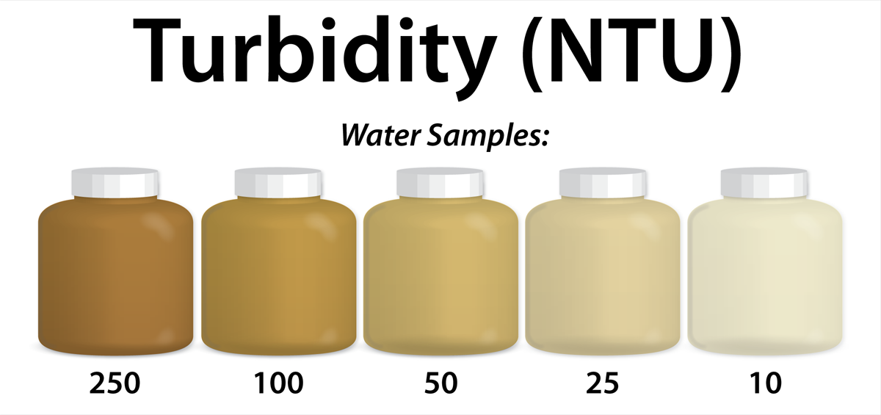
Environmental Engineering
Part 2:
  Compete against other groups in your company to design the best remediation system!
  Lowest Turbidity wins!
Notes:
Ask them to hold general questions about the discipline until the end of the activity during the questions and answer session. The activity should be only 30 mins.

Slide 6
Environmental Engineering
Budget: $100
Material (Qty) | Cost ($)
coffee filters (1) | $35
cotton balls (4) | $10
plastic spoon (1) | $10
straws (4) | $25
sand (1 cup) | $40
gravel (1 cup) | $40
cheesecloth (1 square) | $35
rubber bands (1) | $10
Notes:
Ask them to hold general questions about the discipline until the end of the activity during the questions and answer session. The activity should be only 30 mins.

