Slide 1
Indiana 4-H Affiliate summit
February 1, 2025 – Monroe County 4-H Fairgrounds
February 8, 2025 – Miami County 4-H Fairgrounds

Slide 2
Welcome and Introductions
Tony Carrell, Acting Assistant Director and Program Leader, 4-H Youth Development
Jamie Morris, 4-H Volunteer Specialist
Lisa Wilson, Area Director
Josh Winrotte, Area Director
Other State 4-H Specialists
Extension Educators
Notes:
Slides 2-5 15 minutes

Slide 3
Indiana 4-H Mission and Vision
Mission
The Indiana 4-H Youth Development mission is to provide real-life educational opportunities that develop young people who will have a positive impact in their communities and the world.
Vision
Indiana 4-H Youth Development s​trives to be the premier, community-based program empowering young people to reach their full potential.

Slide 4
Today’s Objectives
Refresh and remind everyone of the Cooperative Extension System organizational structure.
Reinforce and strengthen all of our understanding and support of the 4-H program.
Expectations, standards and the why they are in place.
Identify resources and best practices to improve communication, support and connections.
Goal of this Summit:
Create a stronger working relationship to support 4-H youth and positive youth development programming in Indiana.

Slide 5
Creating Connections
Notes:
Jamie and Lisa
15 minutes

Slide 6
4-H Affiliate’s Role in the 4-H Structure
Lisa Wilson and Josh Winrotte
Area Director Liaisons
4-H Organizational Structure in Indiana
What the ABE says about Working Together
MOU's set the Stage
Partnerships make the Dream Work
Volunteers and the Role Description
Q and A
Notes:
40 minutes

Slide 7
4-H Organizational Structure
USDA/NIFA
18USC707
Land Grant Universities
Purdue University
County Educators
4-H Affiliates

Slide 8
What the ABE says about Working Together
In my role as a 4-H Youth Development Program faculty, educator, staff, or volunteer I will:
Respect, adhere to, and enforce the rules, policies, and guidelines established by the Purdue University Cooperative Extension Service including all laws related to child abuse and substance abuse.
Accept supervision and support from salaried Extension staff or designated management volunteers.
Participate in orientation and training, which includes youth protection standards, sponsored by the Purdue Cooperative Extension Service.
Accept my responsibility to represent 4-H Youth Development Programs with dignity and pride by being a positive role model for youth.

Slide 9
Volunteers and the Role Description
Our educators have job descriptions and expectations!
Educators are expected to:
Plan Programs for youth and families
Serve as the Volunteer Coordinator for the program
Comply with all USDA, BOAH, and Indiana Dept of Ag regulations
Participate in Professional Development and Training
Work with Educators in their area on local, regional, and State Programming
Work alongside ANR, HHS, and Community Development Educators on local programming
Lead and Participate in Needs Assessment of both 4-H and Youth Development work in their local community

Slide 10
Volunteers and the Role Description
Just like our educators have job descriptions, so do you as volunteers!
Why do you need a Role Description
Volunteer = unpaid employee
Unpaid Employee means
Insurance protection and legal protection provided with that status
All big decisions need the Educator (Paid Professional),so that we can protect volunteers in their role
The Role Description gives guidelines and expectations for the relationship between Educator and Volunteer
Volunteer = Clear Expectations
Everyone knows what they need to do and be
Appreciation for one anothers efforts and time

Slide 11
Questions and Answers
What Questions can we Answer?
Contact Information for Lisa and Josh:
Lisa Wilson – Southwest Area Director
Lisawilson1@purdue.edu
Josh Winrotte – Northwest Area Director
Jwinrott@purdue.edu

Slide 12
BREAK

Slide 13
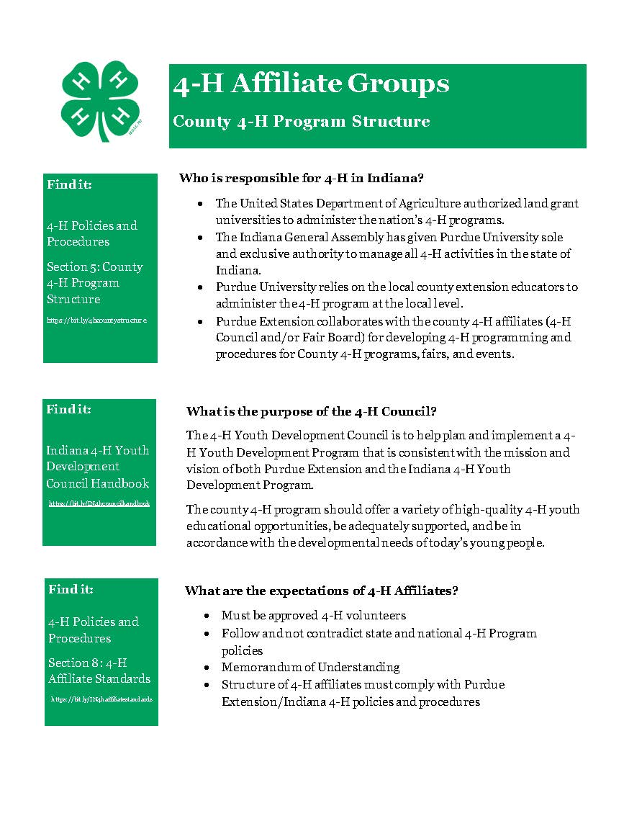
The Why and How of 4-H Affiliate Standards
Indiana 4-H Policies and Procedures
Designed to provide clarity in roles, best practices and legal requirements.
Indiana 4-H web site, About, Policies and Procedures
Section 5- https://bit.ly/4hcountystructure
Section 8- https://bit.ly/IN4haffiliatestandards

Slide 14
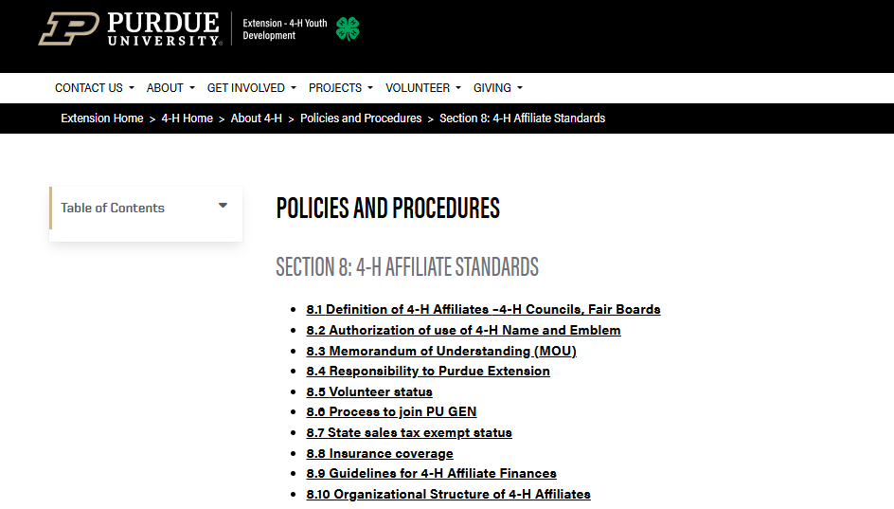
The Why and How of 4-H Affiliate Standards
Indiana 4-H Policies and Procedures

Slide 15
Insurance Protection
Provided by Purdue University and Purdue Extension
Activity Insurance – accident and injury, secondary policy, covers most out-of-pocket medical expenses, protects 4-H members and approved volunteers.
Liability Insurance– protects approved volunteers when accused of wrongdoing and affiliates in good standing, must be working on behalf of 4-H for educational purposes and not be acting negligently.
Property Liability Insurance– coverage provided when a 4-H group uses a third-party facility during an approved 4-H event and 4-H damages that third party facility.

Slide 16
The Why and How of 4-H Affiliate Standards
Indiana 4-H Policies and Procedures
Section 8.10- Organizational Structure of 4-H Affiliates
Volunteer Status- Council/Board members must be approved volunteers before they can vote.
Term Limits- Maximum of 2 4-year terms with a 1-year hiatus before returning.
Officers- Elected annually with a maximum of 3 consecutive 1-year terms.
Anti-Nepotism- Membership limited to one member from the same family.
Conflict of Interest Policy- Members will not use their positions or knowledge gained for personal benefit.
Youth and Adult Partnership- include youth members on council/board with voting rights.

Slide 17
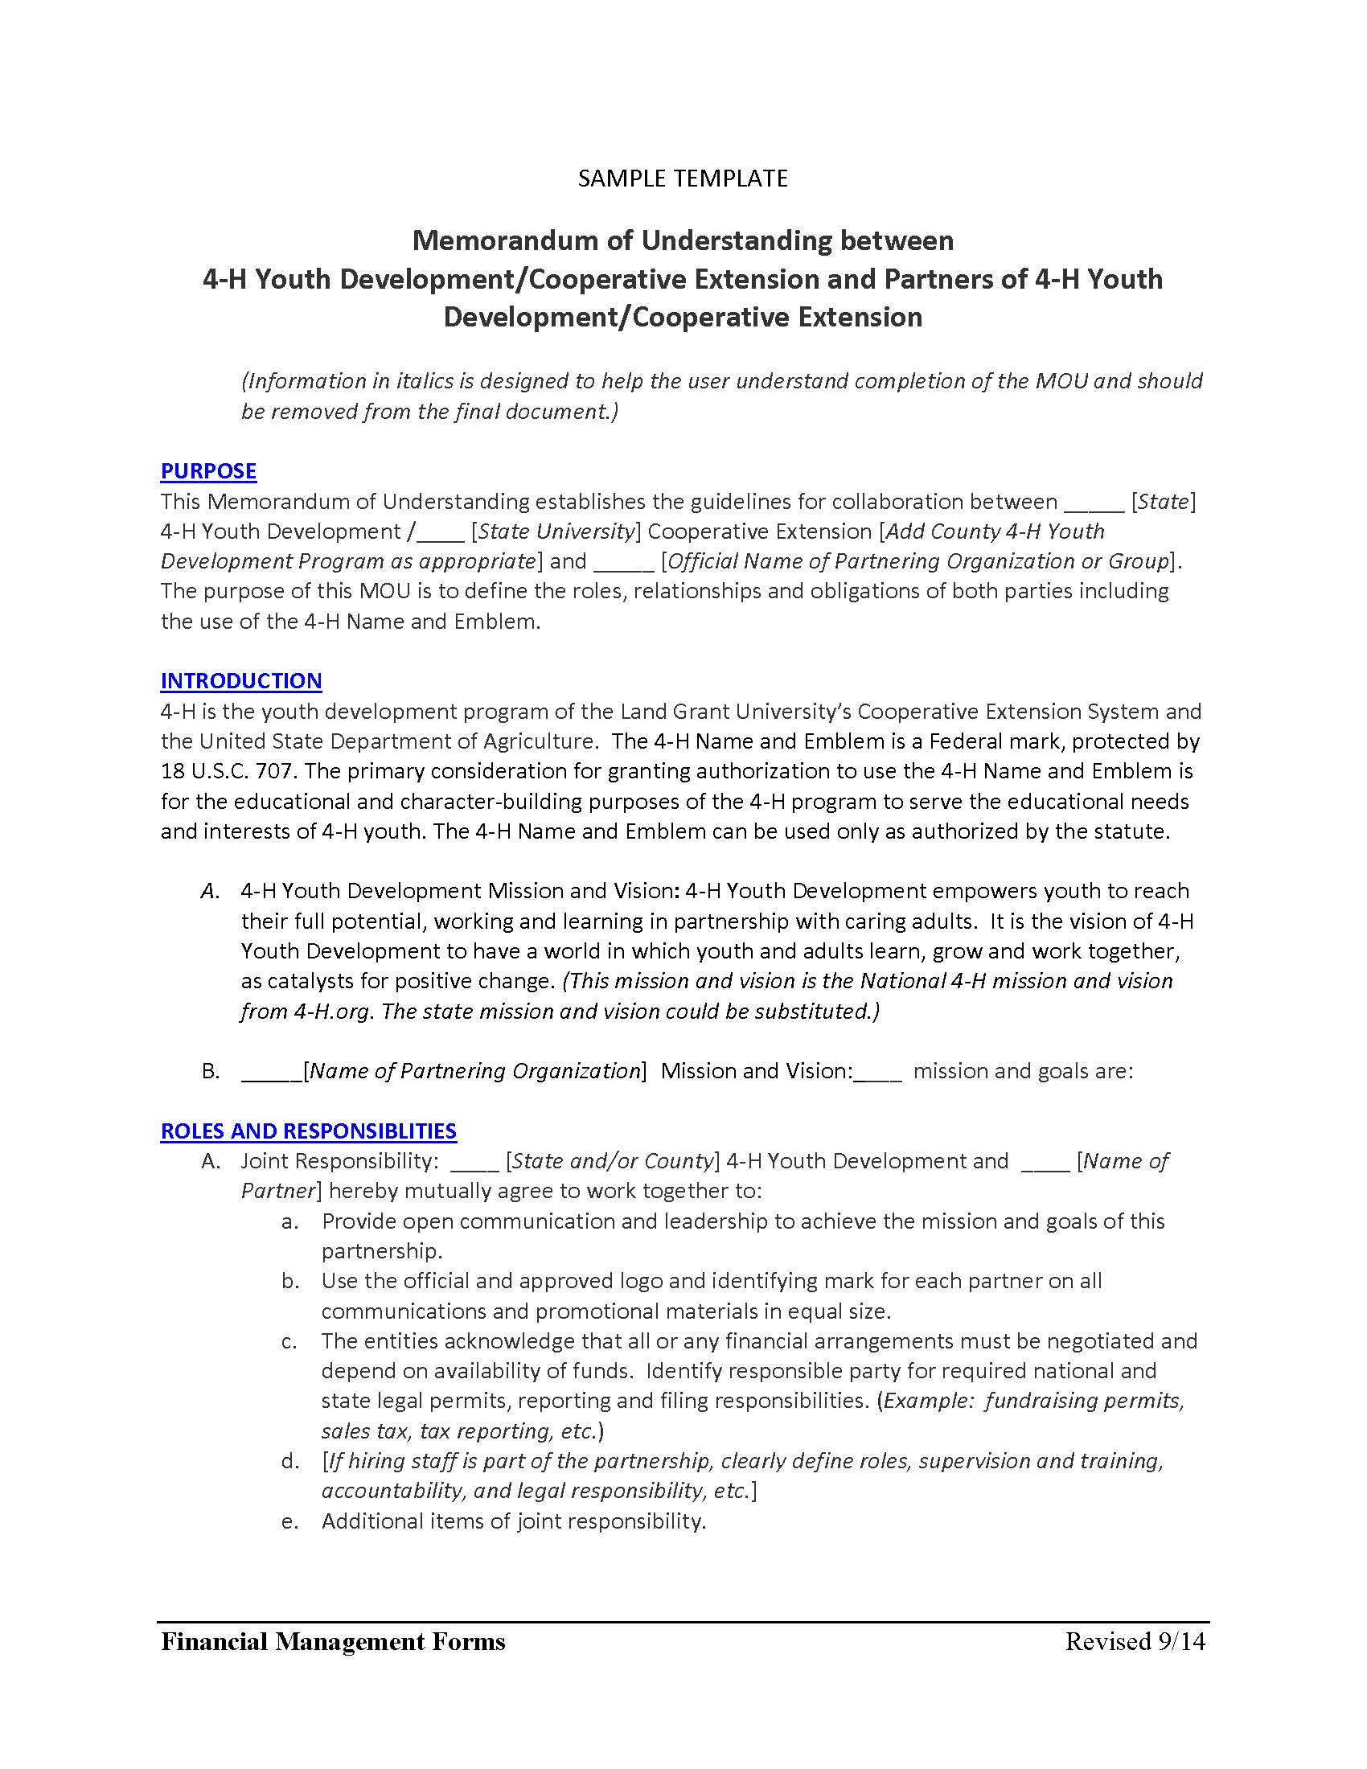
Memorandum of Understanding
Originally implemented in 2008 and updated in 2012 to align Affiliates with PU GEN.
Required by every Indiana 4-H affiliate organization.
Outlines on paper each party’s responsibilities and how everyone works together to deliver 4-H educational programs.
By January 2026, 4-H Educators asked to update MOU's to reflect current responsibilities.
Recommended to review and update every 3-5 years or when significant changes to the relationship occur.
Notes:
MOU’s (template), give examples of why the MOU’s are needed and why the affiliate standards are in place, make it well known that Purdue does not want to take over or control affiliate groups. Purdue does want to make sure the money raised in the name of 4-H are used and managed within our expectations. Reiterate the why behind the affiliate standards and the need to adhere to them if they wish to be a 4-H affiliate. (Create an open and inclusive environment that provide voice and representation of the whole community so we can serve the whole community).

Slide 18
LUNCH AND
NETWORKING

Slide 19
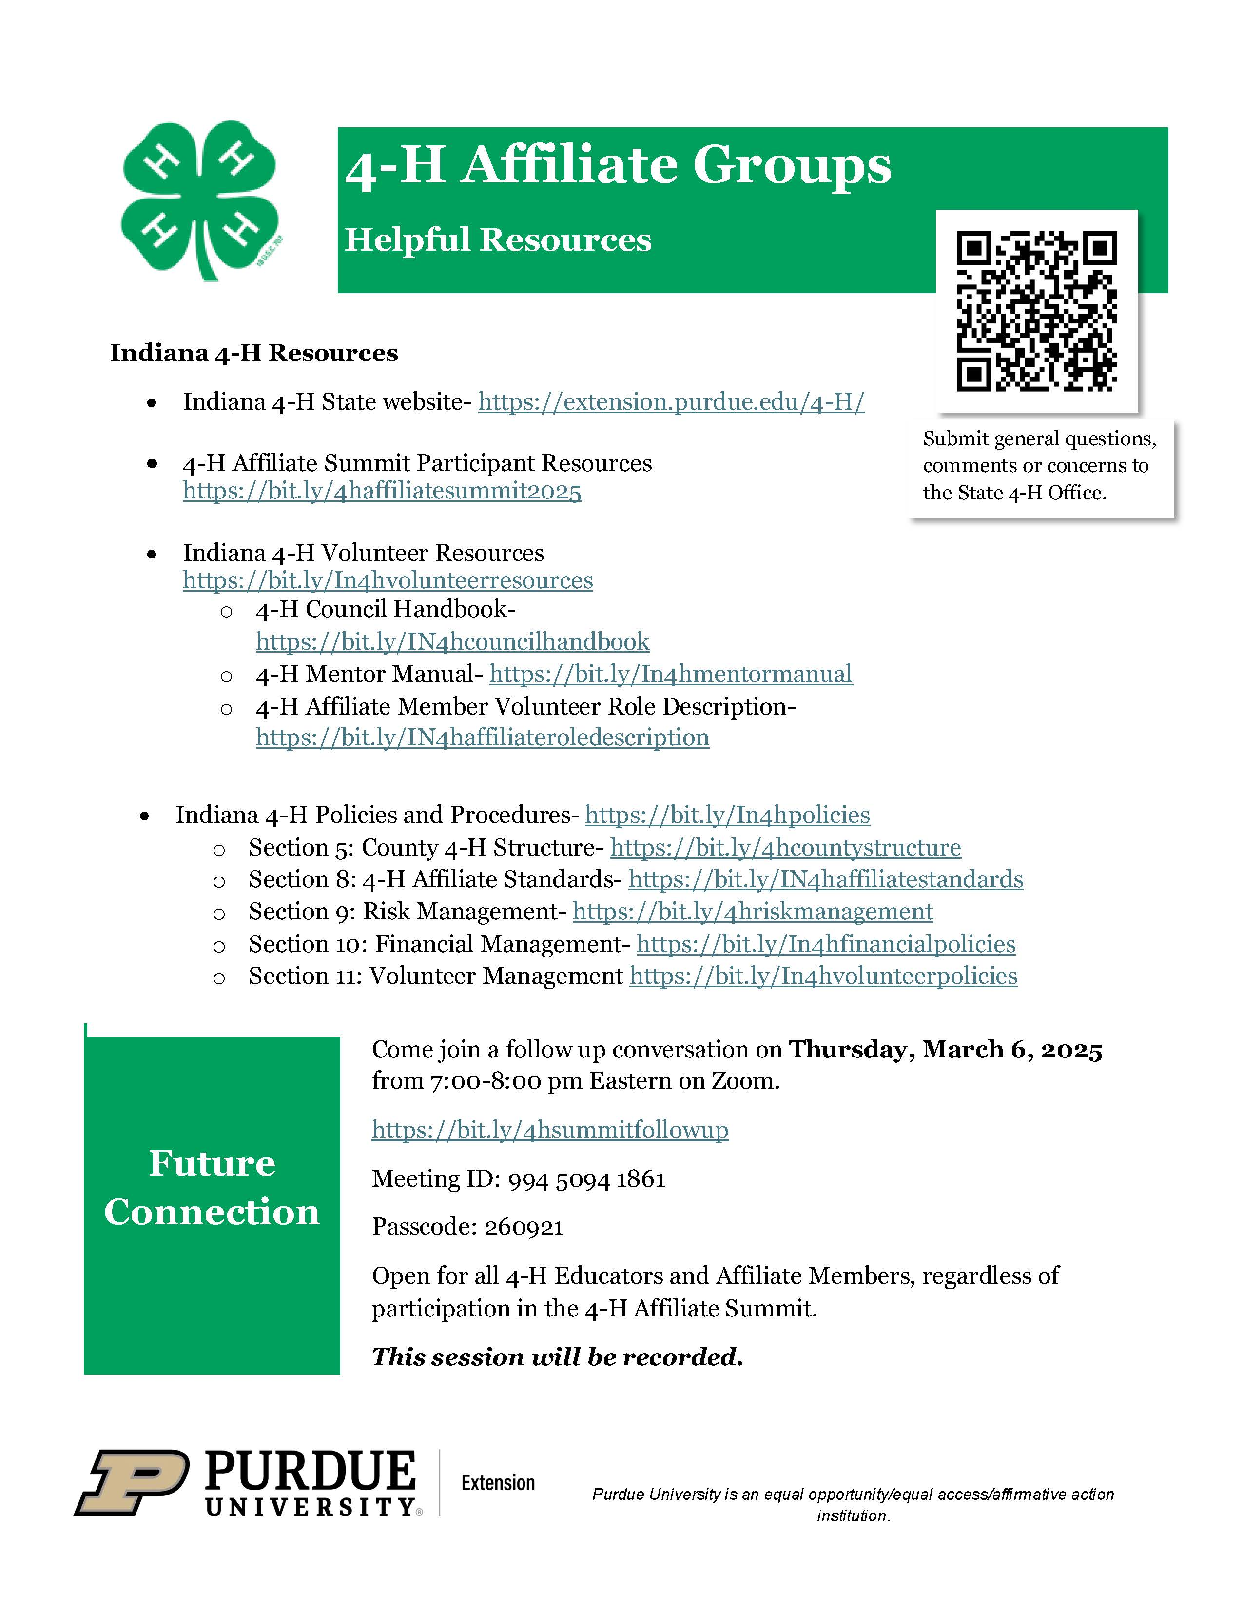
Making the Best Better
Best Practices and Resources
Remember you are a leader and role model for Indiana 4-H!
Consider creative ways to promote and recruit new members
Orientation for new members and annual orientation to refresh purpose and strengthen foundation
Create Ground Rules and Meeting Expectations
Survey skills, interests and needs of members
Create a strategic/annual plan
Work to strengthen connections

Slide 20
BREAK AND
NETWORKING

Slide 21
What do you need from us?
Roundtable Discussions
Work to strengthen connections
Each table will get copies of the roundtable questions Identify a table facilitator and note taker, best if they are different people.
Facilitator will be responsible for encouraging open and respectful conversation about the questions.
Note taker will record (summarize/bullet) responses to the questions.
Notes will be collected for follow up meeting prep and potential FAQ.

Slide 22
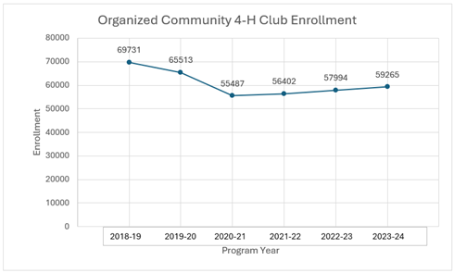
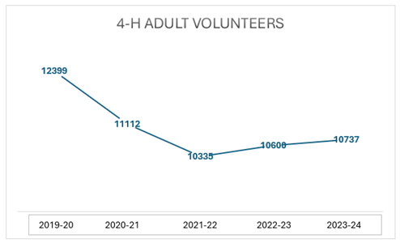
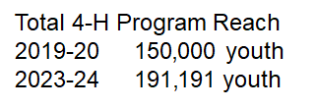
Indiana 4-H is GROWING!

Slide 23
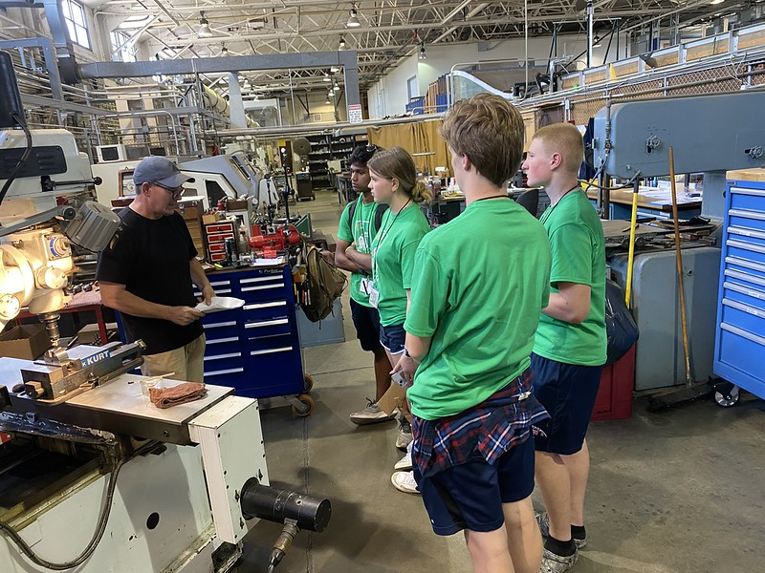
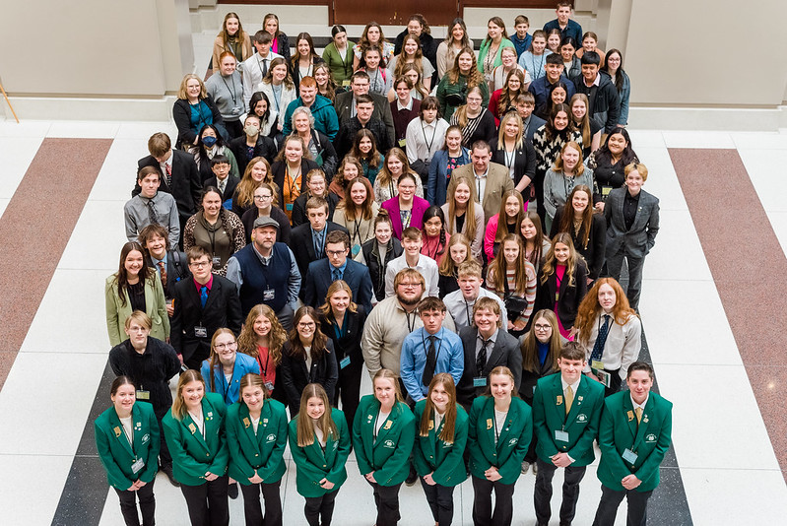
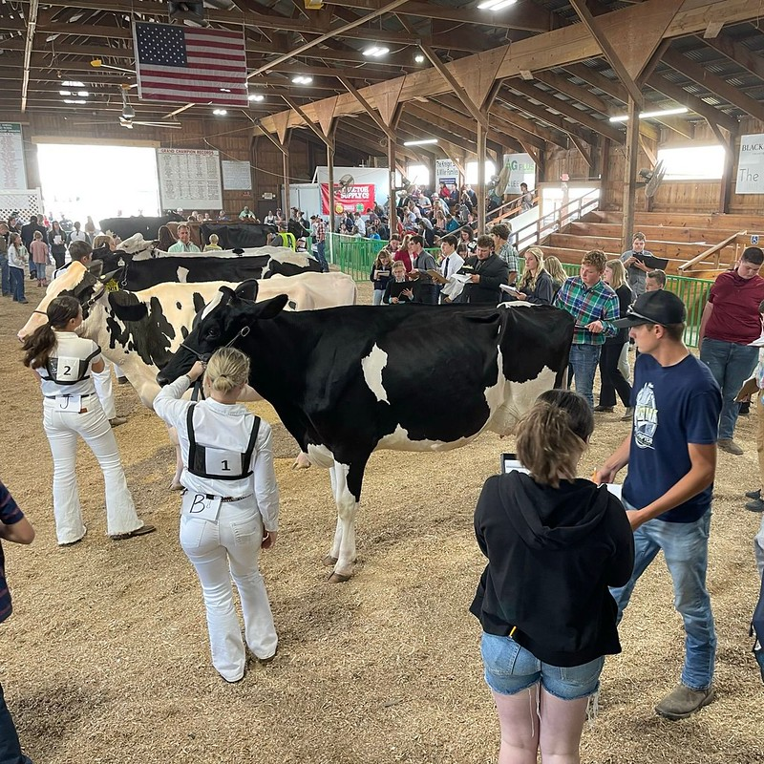
Thank you for all you do!
YOU are essential to Indiana 4-H and Indiana 4-H'ers!

Slide 24
THANK YOU!

