Slide 1
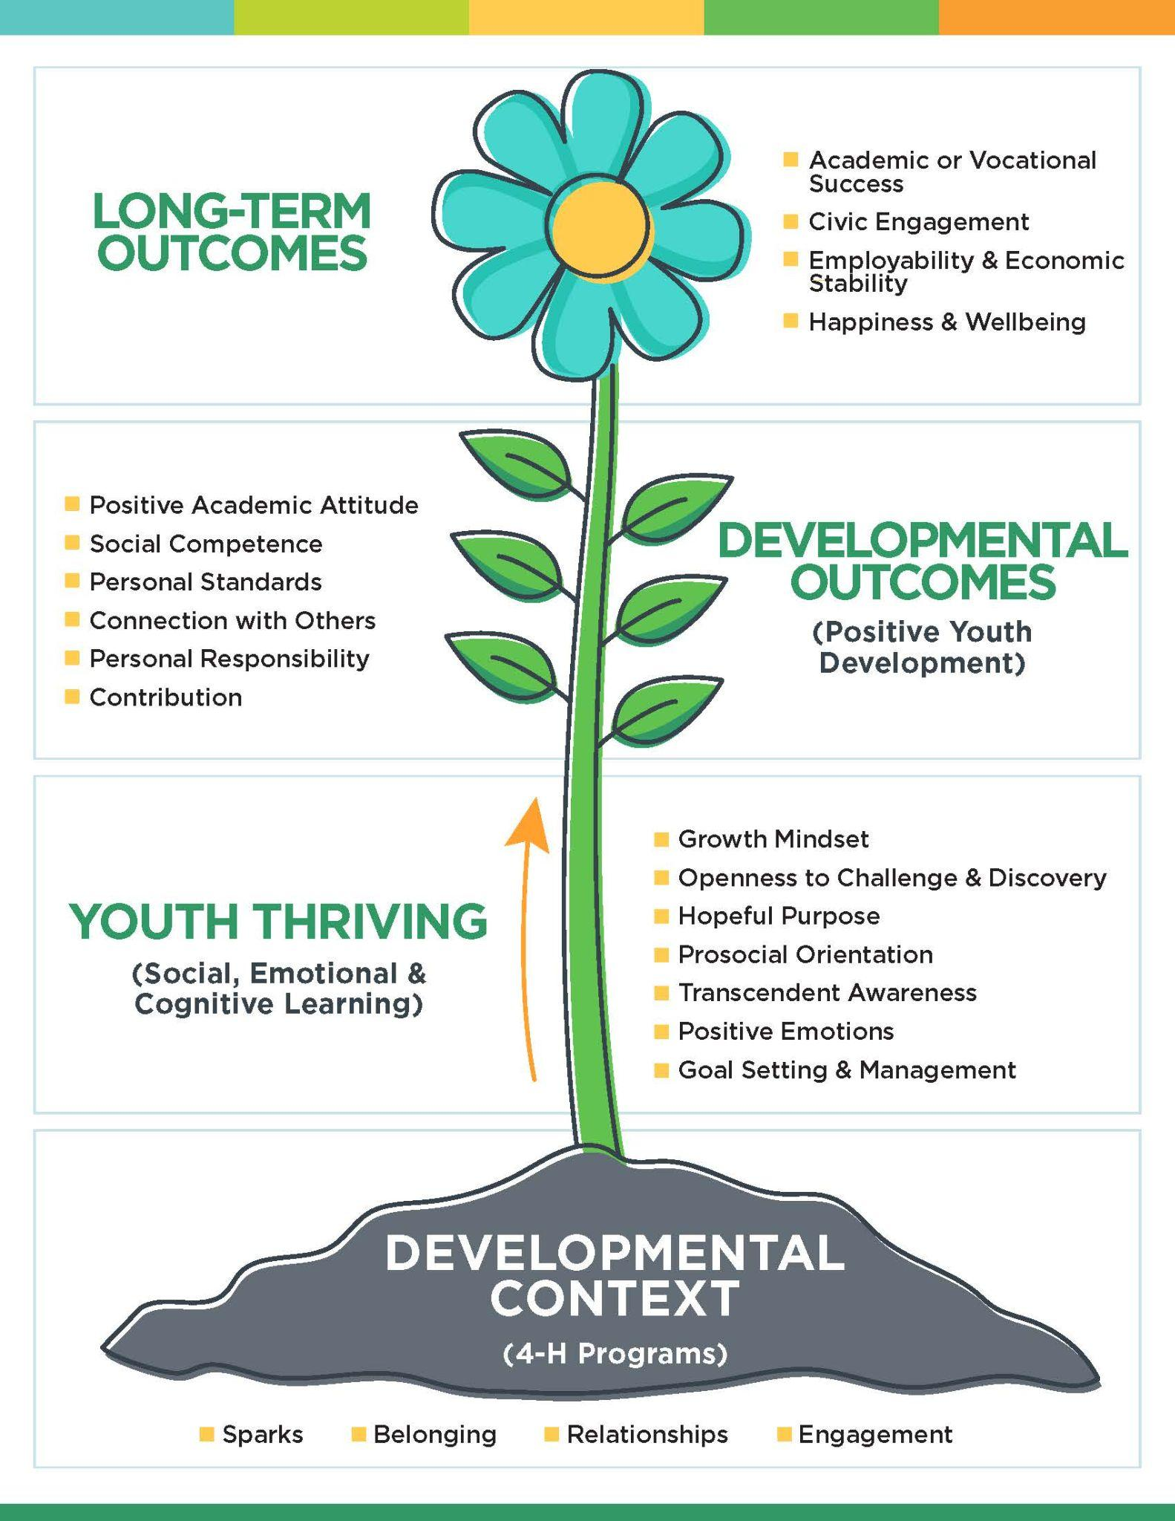
Back to the Basics
for 4-H to Grow and Thrive
Getting Parents Engaged
Levels of involvement

Slide 2
4-H Thriving Model
Notes:
4-H is based on a positive youth development (PYD) approach that recognizes all youth have interests, abilities, and strengths that can be enhanced by participation in 4-H programs. Research shows that participation in high quality 4-H programs increases thriving in youth, and thriving youth achieve important developmental outcomes, such as academic motivation and achievement.
Side note- There is a hand-out of this model to see how the Thrive Model works.
This growth happens over time in our 4-H programs. Could be short-term focused content programing or a year-round community club environment. We support positive youth development in many different ways.
To have an active 4-H membership, we need the support of not only 4-H volunteers but the 4-H members’ parents.

Slide 3
Getting Parents Engaged
Understanding the goals and mission of the 4-H program
What we are wanting youth to gain from the 4-H program
Host a “Rookie Parent” Meeting
Moving parents to volunteers
Ask them to help
Use the “Volunteers Needed” sheet
Level of involvement
What volunteer type suits you
Have parents understand the expectations of the different roles
How they can be successful in their volunteer role
Notes:
We have created some tools to help assist in the engagement of 4-H parents…from a survey to ask how they may help volunteer, to having a separate meeting for first time 4-H parents to learn more and ask questions about 4-H.
Handout examples:
Mentor Manual Parent overview page
Volunteers Needed survey for parents to fill out
Rookie Parent Meeting agenda

Slide 4
Getting Kids Engaged
Keeping 4-H Fun
Running your meeting
Are you saying the pledge, using parliamentary procedure, electing officers in your meetings?
Are you planning meetings/activities/events with your youth’s input?
Different learning styles and ages of youth
Suggested sequences for processing information
Using fun resources for recreation
Energizer activities and mixers
Socializing and team building activities
Interactive demonstrations
Service learning activities
Notes:
Reminder, when we are developing our support for the 4-H clubs with parents, we have to keep the event/meeting exciting for the youth as well.

